Slide 1







Slide 2


מקרי בוחן
מחלוקות מהשטח
של יהדות ארה״ב

Slide 3

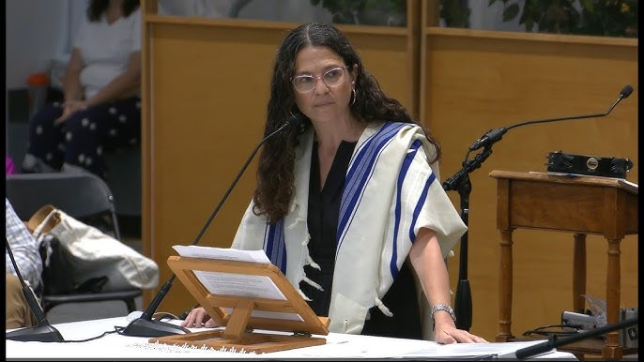
Rabbi David Ingber vs. Rabbi Sharon Brous
Rabbi Sharon Brous
  Founding rabbi of IKAR (est. 2004), the influential nondenominational Los Angeles congregation; among the most prominent liberal clergy in America
  Delivered a blessing at President Biden's 2021 inaugural prayer service; author of The Amen Effect (2024)
  A leading voice of "prophetic Judaism": Jewish credibility depends on moral accountability, including public confrontation with occupation and settler violence
  A Zionist who affirms a Jewish and democratic state — but warns that branding all criticism or Palestinian solidarity as antisemitic weakens the fight against real antisemitism

Slide 4
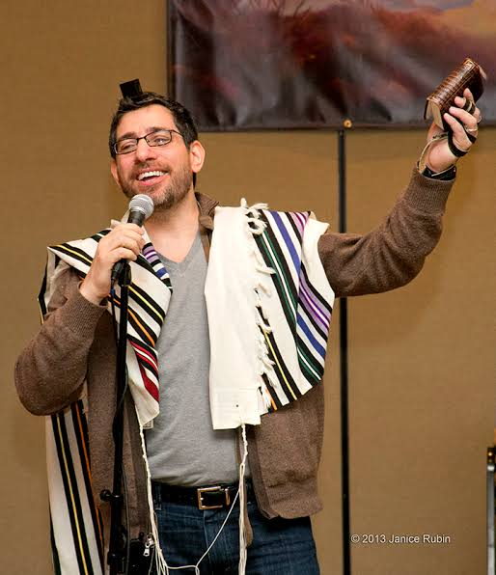
Rabbi David Ingber vs. Rabbi Sharon Brous
Rabbi David Ingber
  Founding rabbi of Romemu (est. 2006), the largest Jewish Renewal congregation in the U.S.; also Senior Director of Jewish Life and the Bronfman Center at 92NY
  Raised Modern Orthodox; ordained by Rabbi Zalman Schachter-Shalomi, founder of the Jewish Renewal movement
  Named one of Newsweek's 50 most influential rabbis in America
  Since October 7: a spiritual progressive turned muscular Zionist — argues progressive rabbis over-indulge public self-criticism of Israel and should name anti-Zionism as a hate movement

Slide 5

Rabbi David Ingber vs. Rabbi Sharon Brous
Being Jewish Podcast, April 14, 2026 (10:19-18:30)

Slide 6
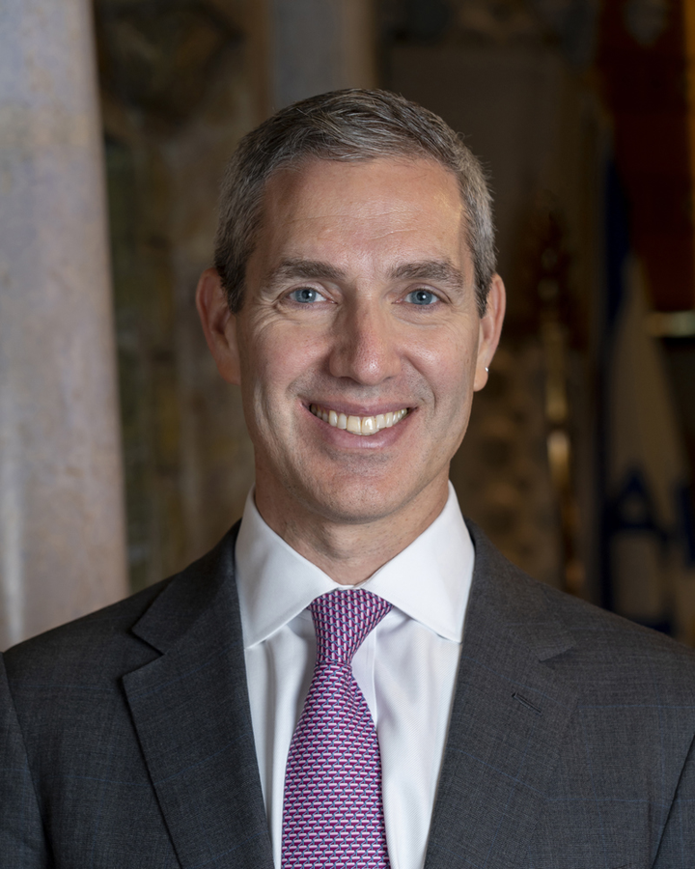
Rabbi Elliot Cosgrove vs. Brad Lander
Rabbi Elliot Cosgrove
  Rabbi of Park Avenue Synagogue — the largest, most influential and wealthiest Conservative congregation, on Manhattan's Upper East Side.
  PhD from the University of Chicago
  One of the most prominent pulpit voices of the American Jewish "establishment center" — liberal on domestic issues, unapologetically Zionist and Israel as core component of Jewish identity.
  His 2024 book For Such a Time as This: On Being Jewish Today, written in the aftermath of October 7, made him a national voice on post-10/7 American Jewish identity.
  Represents mainstream engaged Jewish world: Donors, people who march at Israel Day Parade

Slide 7
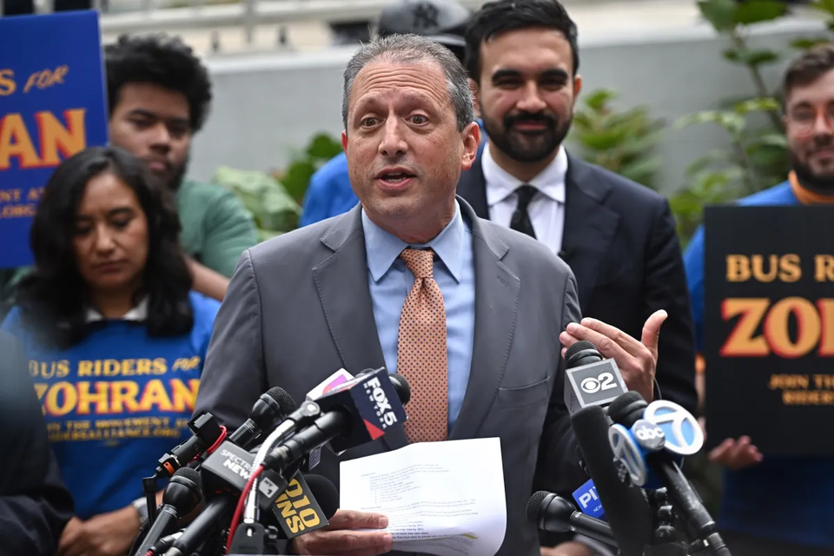
Rabbi Elliot Cosgrove vs. Brad Lander
Brad Lander
  Progressive Jewish politician from Brooklyn,
  New York City Comptroller (2022–2025).
  Lander ran for mayor in 2025 and also endorsed Zohran Mamdani under ranked-choice voting, lending Mamdani crucial legitimacy with Jewish and establishment-liberal voters.
  In June 2026 he defeated incumbent Rep. Dan Goldman in the Democratic primary for the heavily liberal Brooklyn/Manhattan 10th District, making him all but assured of winning the congressional seat in November.
  Not anti-Zionist but said Israel's destruction of Gaza meets the definition of genocide
  Built his political career in coalition with the DSA-aligned left.
  Deeply identified as a Jew
  Represents growing cohort of American Jews, especially younger ones, who insist their harsh criticism of Israel — up to and including the genocide charge — flows from their Judaism rather than against it.

Slide 8
Eliot Cosgrove, “A 2028 letter to losing Brad Lander” June 30, 2026
And when your new friends went silent as you were ripped apart by someone even purer than you, you finally understood what abandonment feels like.
They told you it was never about being a Jew — only about being a Zionist — as if the two could be peeled apart, as if your Jewishness had nothing to do with the nation they demanded you disown.
There’s an old teaching about the man who thinks he can ride the tiger and dismount whenever he likes. You didn’t tame the coalition you joined. You were, for one term, useful — until the moment it decided to disown you. You could renounce the policy, the lobby, even Zionism, but you could not renounce being a Jew.
. . . .you called Israel’s war against those seeking its destruction a “genocide” — and pointed to your own Jewishness as the credential to say so.
. . . you refused AIPAC’s money as a badge of honor and stood silently as Mayor Mamdani called AIPAC “monsters” trafficking in “dark money” — one of the oldest and ugliest antisemitic tropes.
We asked you to stem the hemorrhaging of Israel support inside your own party, to name the line between anti-Zionism and antisemitism — you stayed quiet on both.
We asked you to be a bridge. You were a tool of convenience.
Because then the DSA fielded one of its own against you and pronounced you a Zionist puppet. You, who built a campaign premised that there was no such thing as too far left on Israel, discovered there is always someone further out on the ledge.

Slide 9
Brad Lander, “My hopes for the rabbi who envisions my defeat — and for a better Jewish future” July 2, 2026
Many Jews are rediscovering [Jewish non-Zionist] traditions, and concluding that they fit better with the Jewish values they learned in Hebrew school.
Your efforts to define them, and me, outside the Jewish community, are dangerously short-sighted. Jews are not made safer by proscribing a particular vision of Israel as the price of full belonging, or by insisting on unconditional support for Israel while it commits human rights violations against Palestinians.
I believe that we need more attention to Hillel’s second question. Our tradition asks us never to become indifferent to the suffering of children. I cannot reconcile Israel’s killing of thousands of Palestinian children with the Judaism that shaped me — most deeply, with the idea that every one of them was created b’tzelem Elohim, in the image of God, just like my kids.
The future you imagine presumes that the greatest danger facing Jewish life is that Jews will leave Zionism. But it seems to me the real danger is that young Jews will conclude there is no room for them inside Jewish institutions unless they silence their conscience. A community cannot thrive if the choices it offers the next generation are hypocrisy or excommunication.
Dear Rabbi Cosgrove,
. . . . Two thousand years ago, Hillel prescribed us a challenge, in two questions: “If I am not for myself, who will be for me? But if I am for myself only, what am I?”
You believe that I am falling short on the first of Hillel’s questions. In our tradition of tokhecha, of accountability, I’ll sit with your criticism and take it seriously.
I believe in the vision of a Jewish and democratic Israel, as imagined in its Declaration of Independence. I just don’t believe there can be democracy with occupation, or that Israel’s present actions in Gaza, the West Bank and Lebanon are consistent with that vision . . .
But even if I were an anti-Zionist, I would still be deeply within Jewish tradition and values

Slide 10
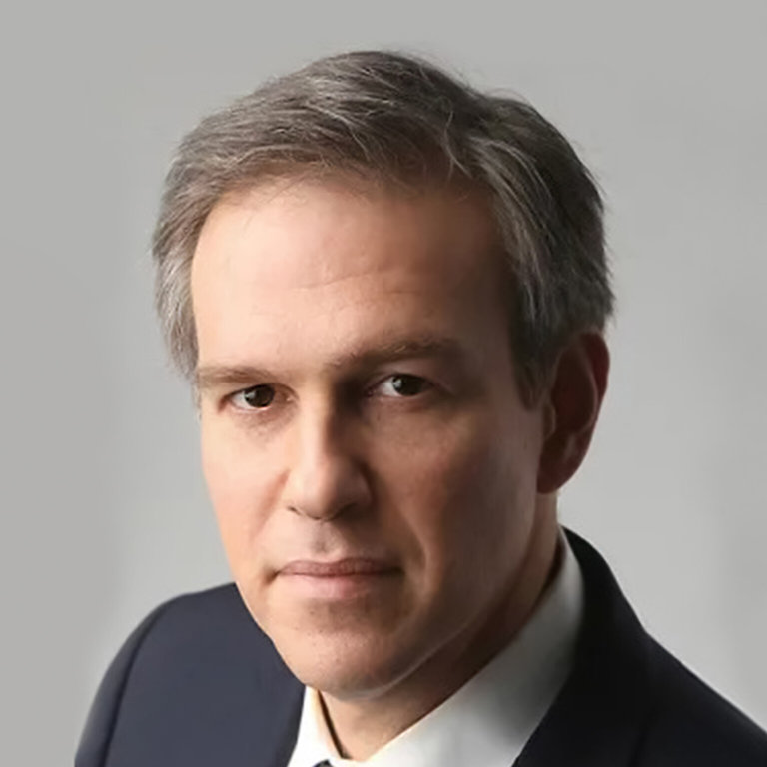
Bret Stephens vs. Jonathan Greenblatt
Bret Stephens
  Pulitzer Prize–winning New York Times columnist
  Leading voice of the pro-Israel center-right in American media
  Former editor-in-chief of the Jerusalem Post; son of a Holocaust survivor
  Founding editor of Sapir, a journal of Jewish thought published by the Maimonides Fund
  Staunch Zionist and "Never Trump" conservative
  Delivered the February 2026 "State of World Jewry" address at 92NY, calling for "dismantling" the ADL

Slide 11
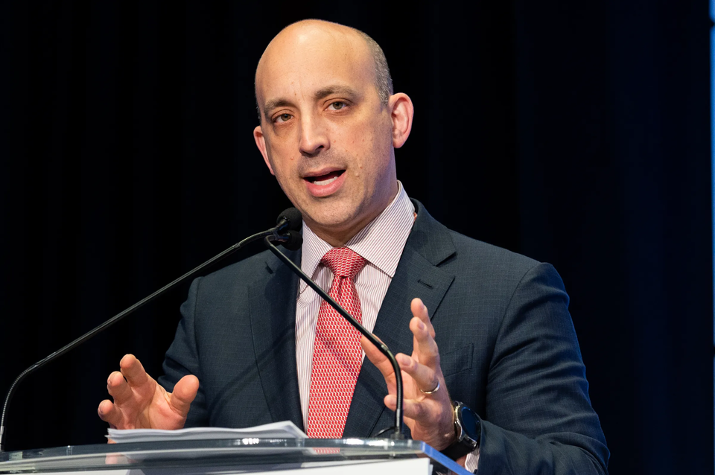
Bret Stephens vs. Jonathan Greenblatt
Jonathan Greenblatt
  CEO and National Director of the ADL since 2015
  Former Obama White House official
  Repositioned the ADL after October 7 to treat anti-Zionism as antisemitism — drawing fire from the left; simultaneously attacked from the right as "woke" and ineffective
The ADL (Anti-Defamation League)
  Founded 1913; the oldest and best-funded Jewish defense organization in the U.S.
  Publishes the annual audit of antisemitic incidents — the most-cited barometer of American antisemitism
  Struggled to position itself during the "Great Awokening": embraced progressive coalition politics and a broad anti-hate agenda (DEI language, boycotting Facebook over hate speech), only to find its progressive allies increasingly anti-Zionist — leaving it attacked from the left when it pivoted back to Jewish concerns, and branded "woke" by the right for having strayed
  Historically a civil-rights organization fighting all forms of hate; critics on the left say it now functions primarily as an Israel-advocacy group, while critics on the right (and Stephens) question whether its model works at all

Slide 12
Bret Stephens, In Praise of Departing
February 5, 2026 (26:21)

Slide 13
Jonathan Greenblatt, Call Me Back Podcast (with Dan Senor),
February 15, 2026 (from 5:00, 8:37)

Slide 14
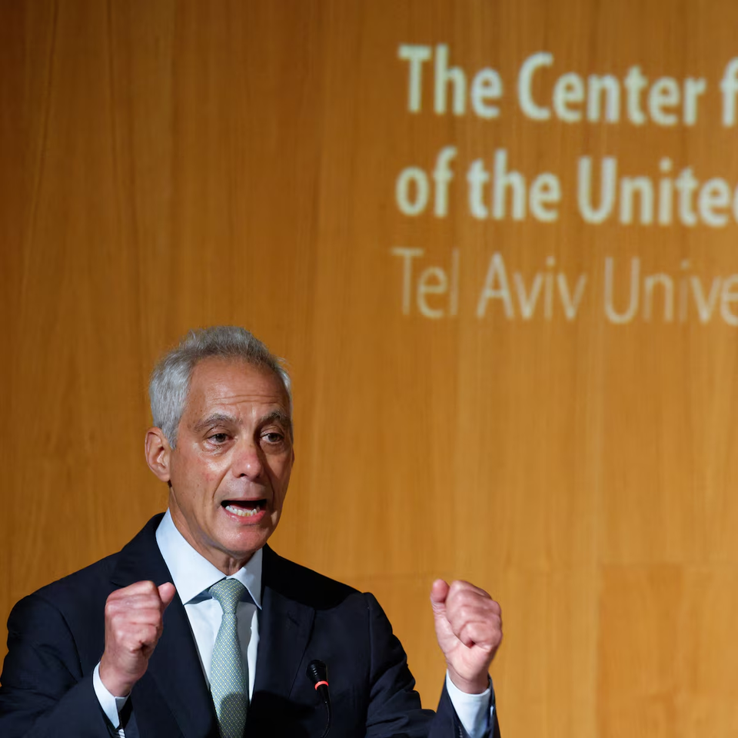
Rahm Emanuel vs. the State of Israel
Rahm Emanuel
  Veteran Democratic power player: senior advisor to Bill Clinton, three-term congressman, White House chief of staff under Obama (2009–10), mayor of Chicago (2011–19), U.S. ambassador to Japan (2021–25)
  Deep Israel ties: son of a Jerusalem-born father who fought in the pre-state Irgun; volunteered as a civilian with the IDF during the 1991 Gulf War
  Now openly positioning for a 2028 presidential run — his Israel stance is part of building that platform
  Long history of friction with Netanyahu, dating to Obama-era settlement fights — Netanyahu once branded him a "self-loathing Jew," a label Emanuel now wears "as armor"
  Positions himself as the pro-Israel critic: rejects anti-Zionism ("I'm not in that camp") while telling Israelis, "You don't have a problem with the Democratic Party. You have an America problem."

Slide 15
Rahm Emmanuel vs. Israel
Tel Aviv University, July 8, 2026
I flew here from Chicago to tell you directly where things need to head if we are going to maintain the historic alliance that binds our two democracies. Without question, the alliance is at a crossroads. It cannot stand or survive as it has been. To maintain the strength of our ties, we need significant changes and a new direction.
Over the last five years, Israel has evolved from being lauded as the start-up nation to becoming, in Prime Minister Netanyahu’s words, a modern-day Sparta. You have turned from being known for your technological prowess to being considered primarily a territorial pariah. You need to think about what that means for your future.
the most important thing a true friend can do is to tell the truth even when it’s painful. And today is a day for truth.
Unconditional [American] support [for Israel] has produced a Prime Minister who has presumed that his strategic interests would incur no cost if he ignored America’s concerns about settlements and sparked a regional war.
Unconditional support has allowed you to deny food and medical relief to innocent Palestinians suffering in Gaza, leaving the world to conclude that Israelis not only want to kill the Palestinians but that they are completely indifferent to their death, destruction, and suffering.
Unconditional support has girded a political coalition in the Knesset that learned it can burn Palestinian farmland in the West Bank and terrorize Palestinian families without consequence.
Given all of this, we need a fundamentally new and different approach to the alliance.

