Slide 1
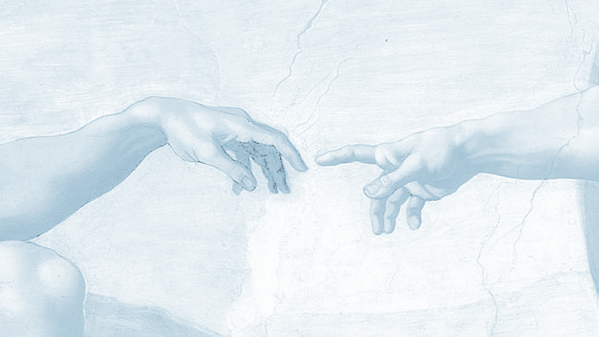


The Role of
the Shaliach as
Connector and
Educator
Today
July 12, 2026
Avigail Ben Aryeh
Joe Schwartz

Slide 2
Goals
To better appreciate and understand:
The society, culture and environment you will be working in
Your role as educator
Our educational approach

Slide 3
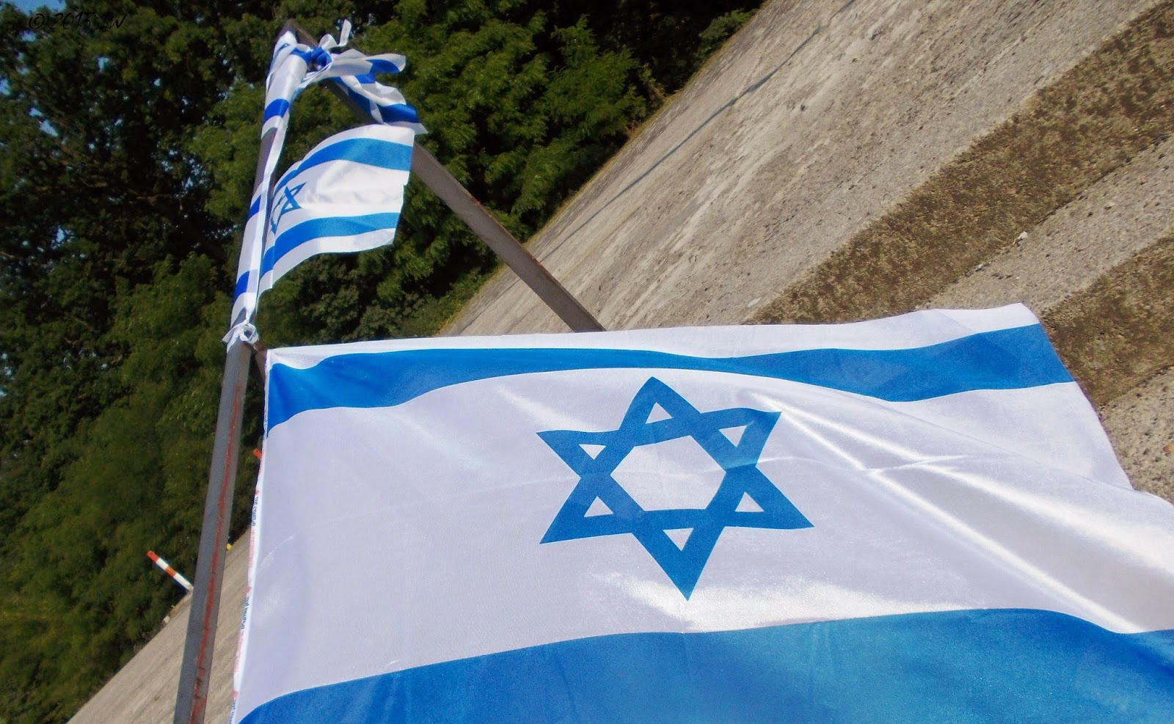
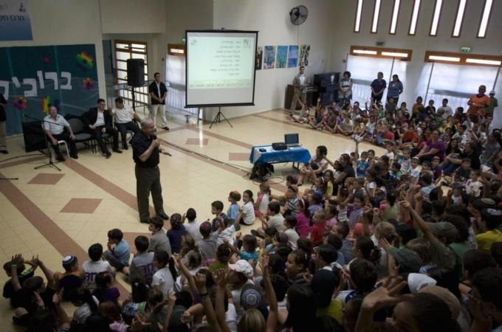
First, let’s think about Israel
Every society is built on its own foundational experiences and traumas - its memories
What are Israelis taught in school about the experiences and traumas that have forever shaped their country?

Slide 4
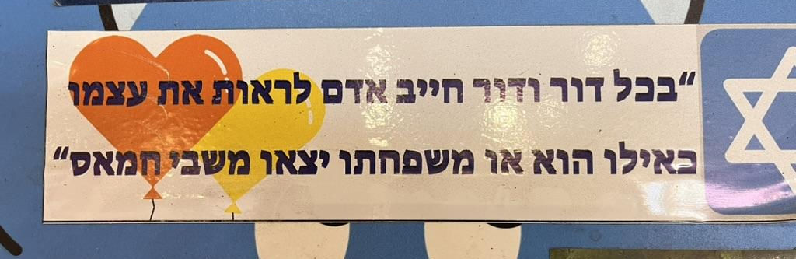
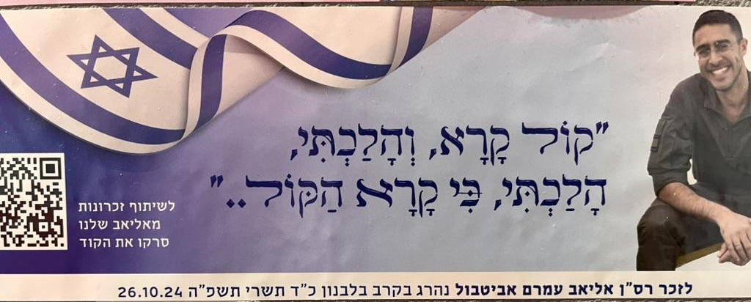
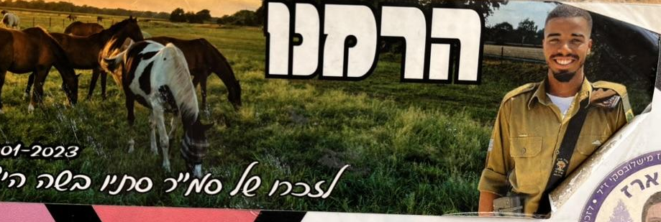
Israel’s Collective Memory
שואה
מלחמות / שכול
אנטישמיות
פליטים.ות
ערבות הדדית
עמידות– חוסן

Slide 5
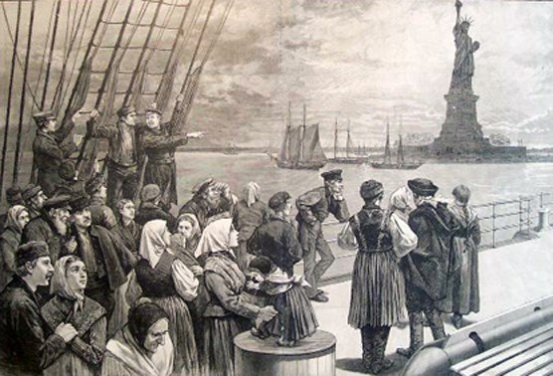
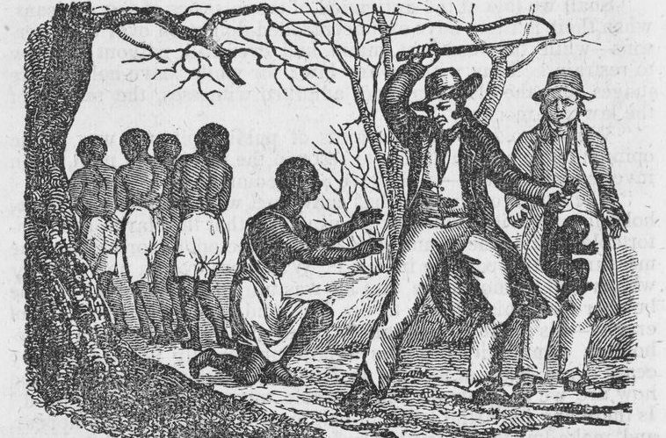
Welcome to America
Every society is built on its own foundational experiences/traumas.
The U.S.A. is built on two:
immigration and slavery

Slide 6
A Nation of Immigrants
U.S. settled by immigrants, dissenters and refugees
The Bill of Rights
→ Freedom of Speech
→ Freedom of Worship
→ No established church
American Liberalism
Pluralism and tolerance

Slide 7
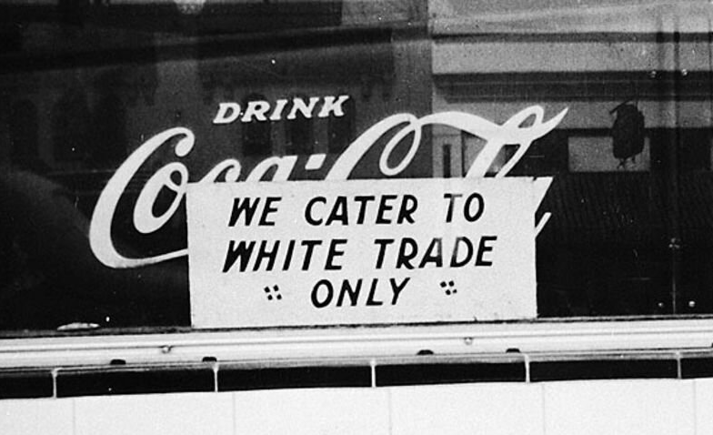
Slavery: America’s “Original Sin”
Civil War (1861 - 1865)
→ Abolishes slavery
Segregation under law
(until 1964)

Slide 8
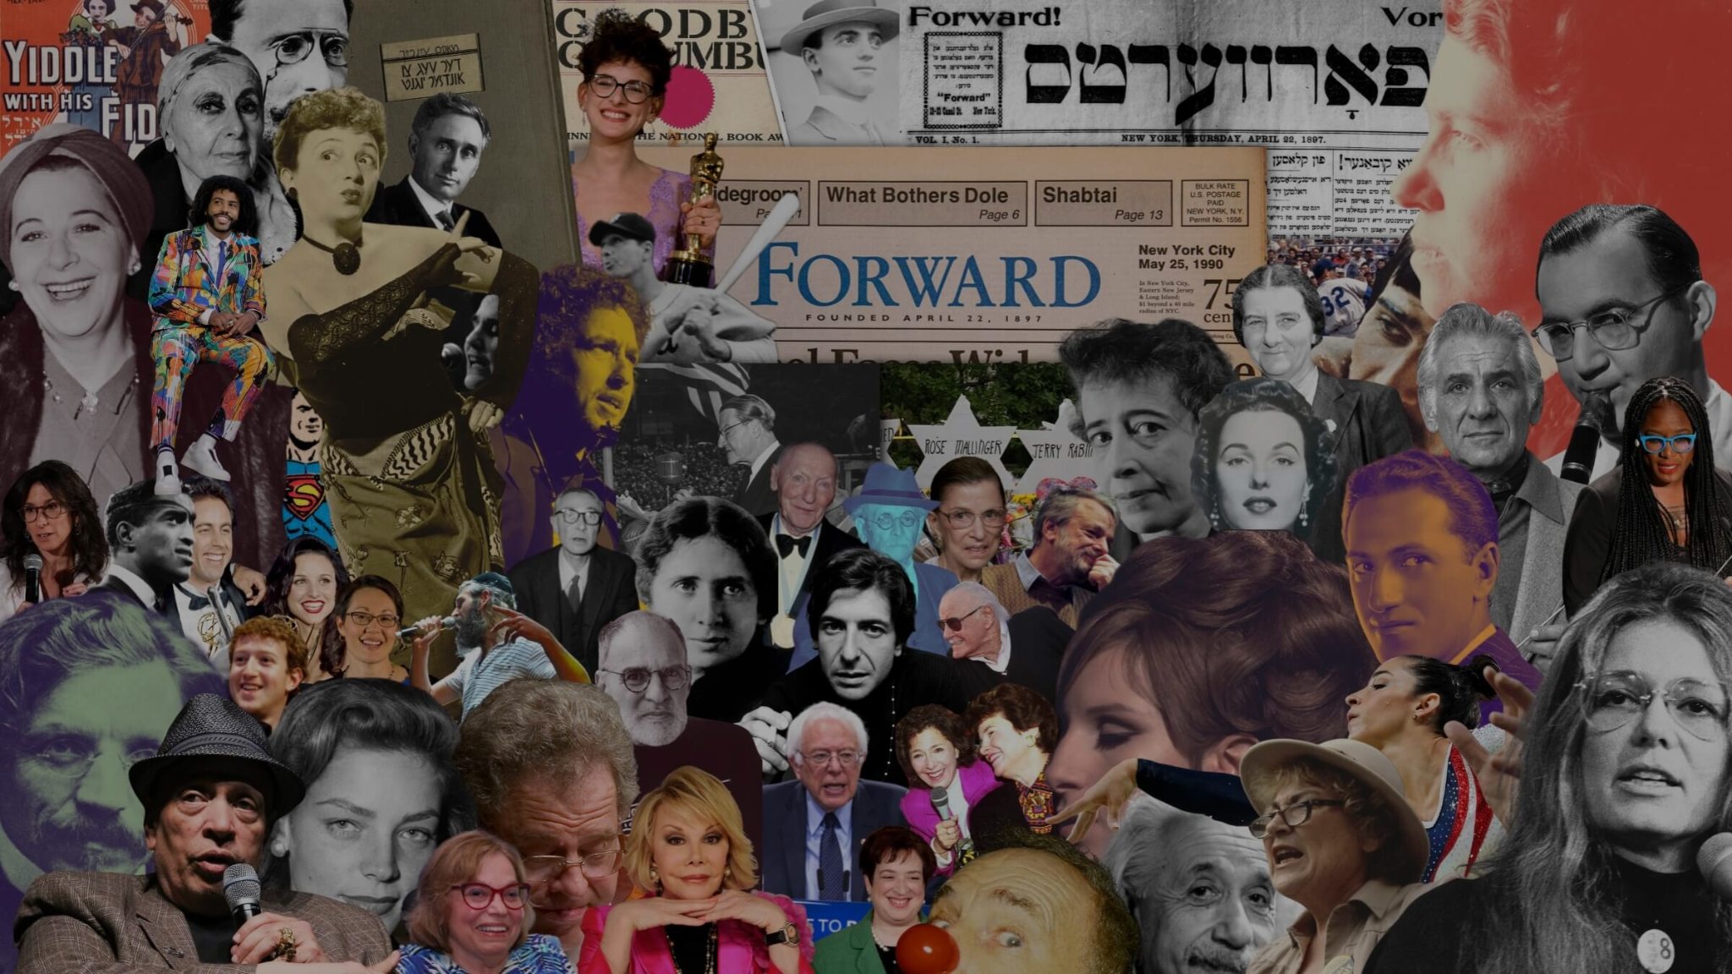
American Judaism
Jews in America become a religious group, not an ethnic or national group.
Judaism is “Protestant” - not “Catholic”. This leads to denominationalism
Overwhelmingly liberal → understand Judaism as liberal
Come to feel at home in America — they are Americans לכל דבר
Complex and conflicted relationship with Zionism and Israel

Slide 9
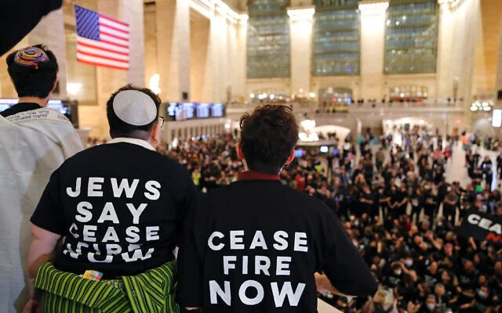
Israel in the American Jewish Conversation Today
Israel is a liability for American Jews - socially and professionally
Most of what we call antisemitism revolves around Israel — Israel’s conduct and American Jews’ role in supporting that conduct
Some will embrace Israel and Israelis nonetheless; others try to distance themselves from Israel and Israelis

Slide 10
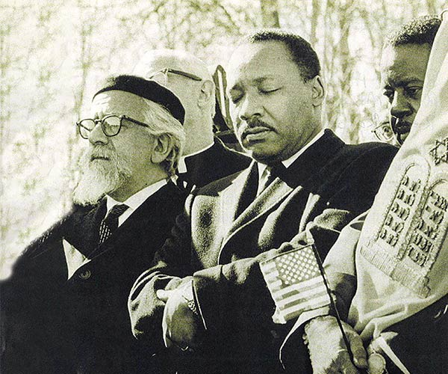
The Jewish Experience in America
Most American Jews arrived around 1900, extremely poor, and rose rapidly
Today, Jews are a “model minority”: Very small numbers (2% of Americans) and at the same, very successful — indeed, the wealthiest group in America.
Jews identify both with other minorities and see themselves as “white” — part of the establishment
Until recently, antisemitism was not a serious issue for most Jews in America

Slide 11
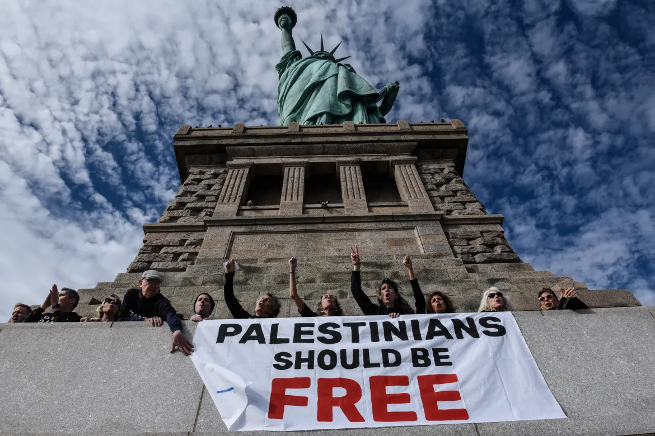
Liberal or Woke?
This is a generational difference:
Most older American Jews are liberal — believing in equality, pluralism, freedom of speech and conscience
→ They see America through the lens of the immigrant story
Most younger American Jews are progressive — or “woke”
→ They see America (and Israel) through the lens of slavery

Slide 12
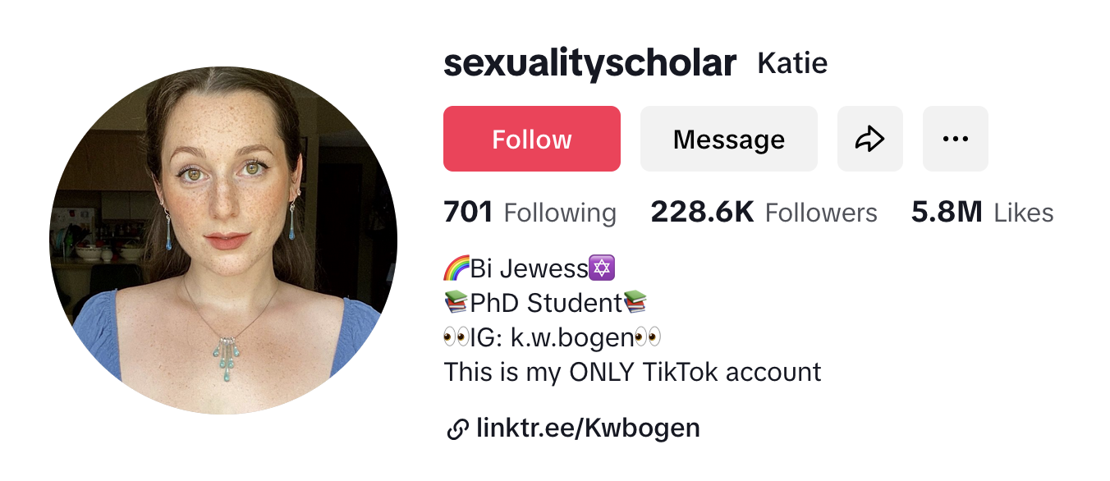
Case Study: “American Jewish Girl Katie”
https://www.tiktok.com/@sexualityscholar/video/7419825483409329454

Slide 13
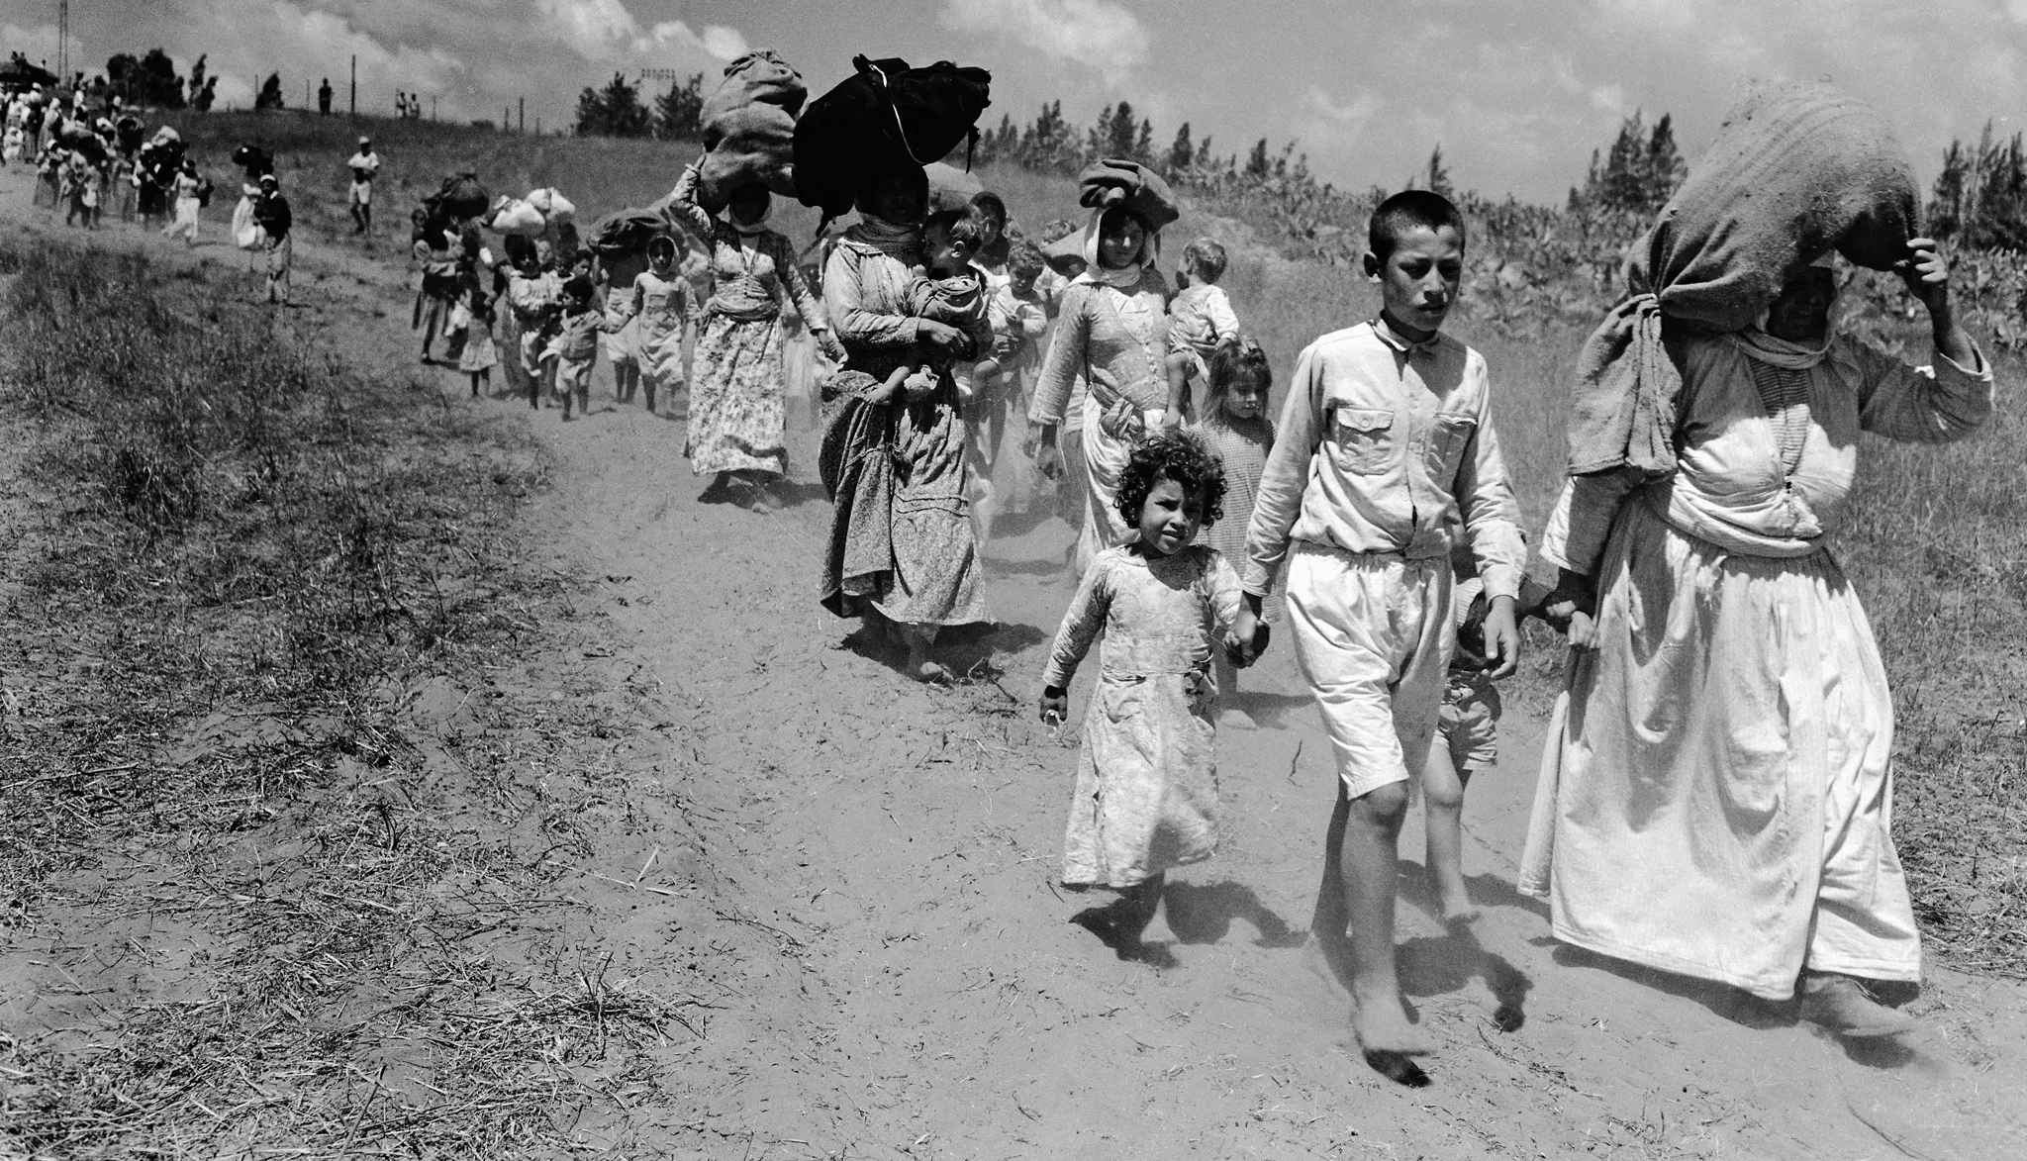
Progressive Antizionist Narrative
Settler Colonialism
Nakba
Jewish (White) Supremacy
Apartheid and Occupation
Genocide
European Zionists emigrate, settle and colonize Palestine, aiming to displace the indigenous Arab population
The State of Israel is founded in sin — the ethnic cleansing of its indigenous people
The state is built on racism and the supremacy of one group (Jews) over another (Palestinians)
Israel’s inherent racial supremacism is expressed in the policies of the State: Apartheid and occupation
All of this leads inexorably to the current war in Gaza, in which Israel seeks to exterminate the Palestinian people

Slide 14

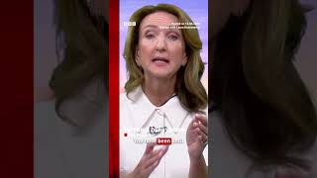
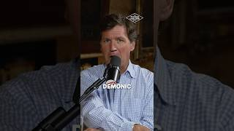
Tucker: The Bottom of the Horseshoe

Slide 15
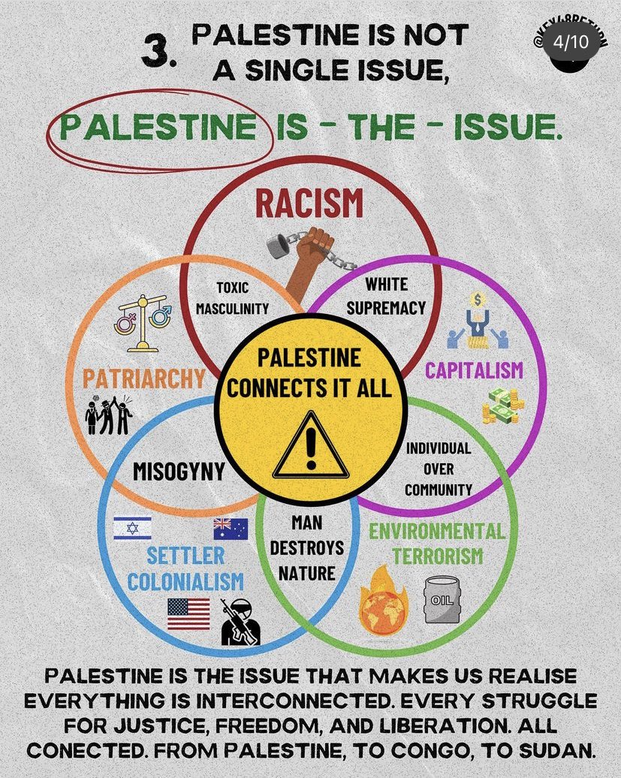
Palestine: The “Omnicause”

Slide 16
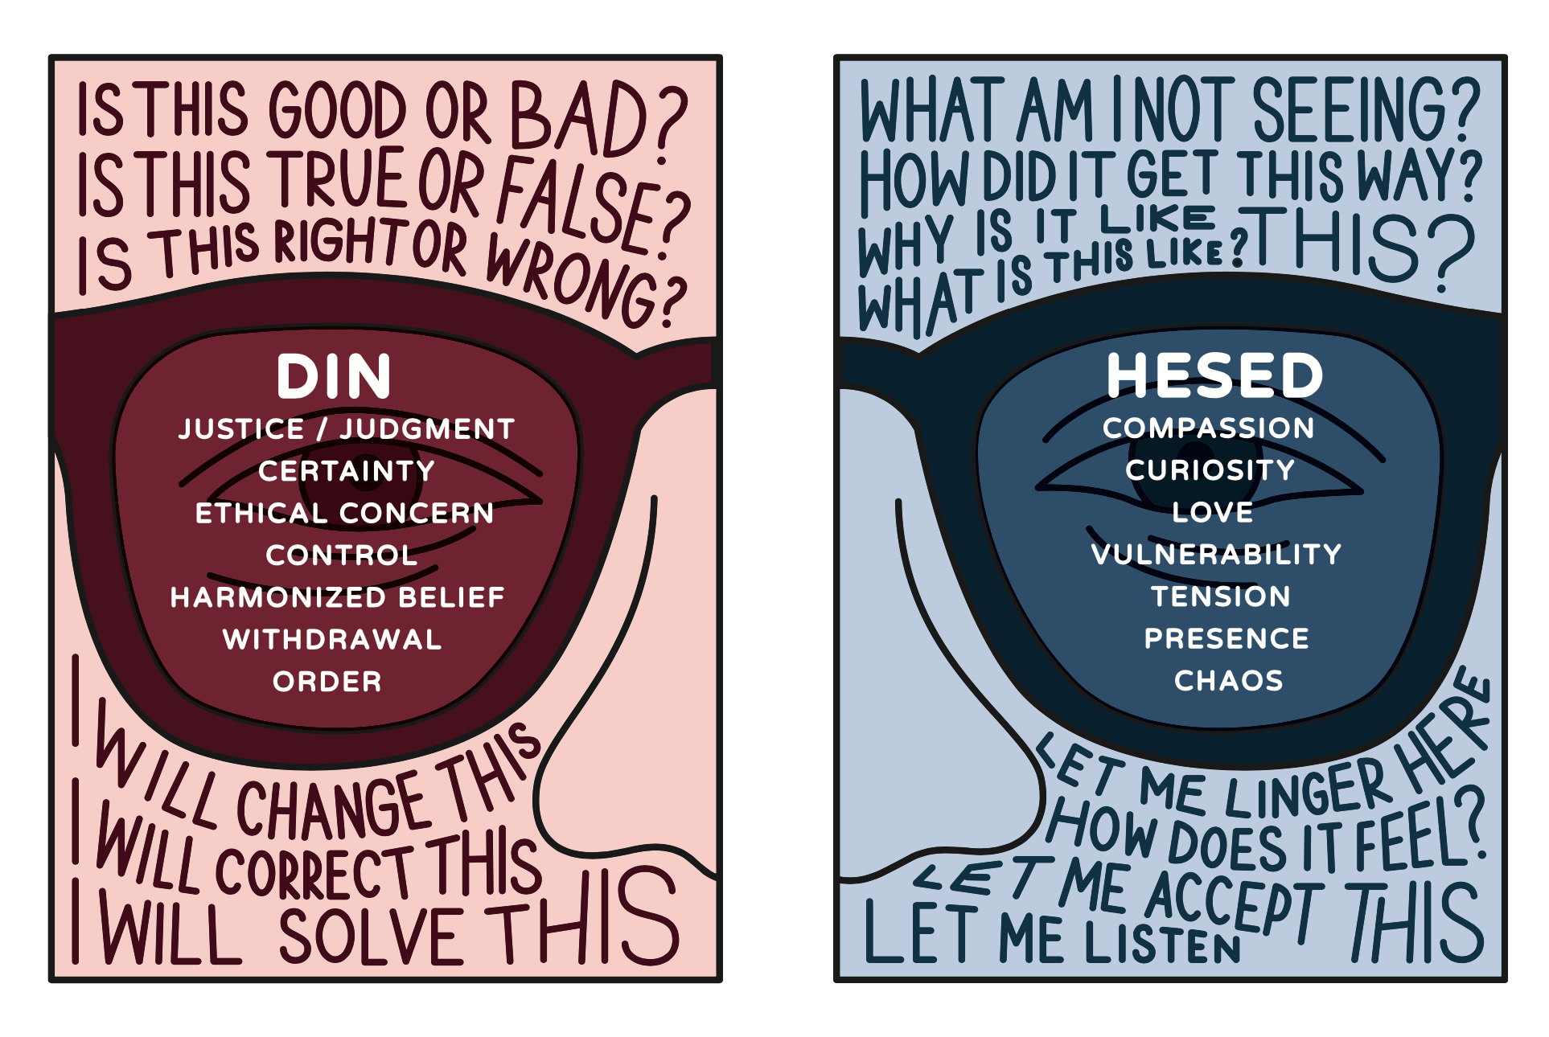
Shaliach as Living Connection to Israel
You embody Israel for American Jews — for good and for ill
You need not defend the conduct of the Israeli state — share your own experience (when it is solicited or welcome)
Lead with compassion and curiosity (“Hesed”)

Slide 17
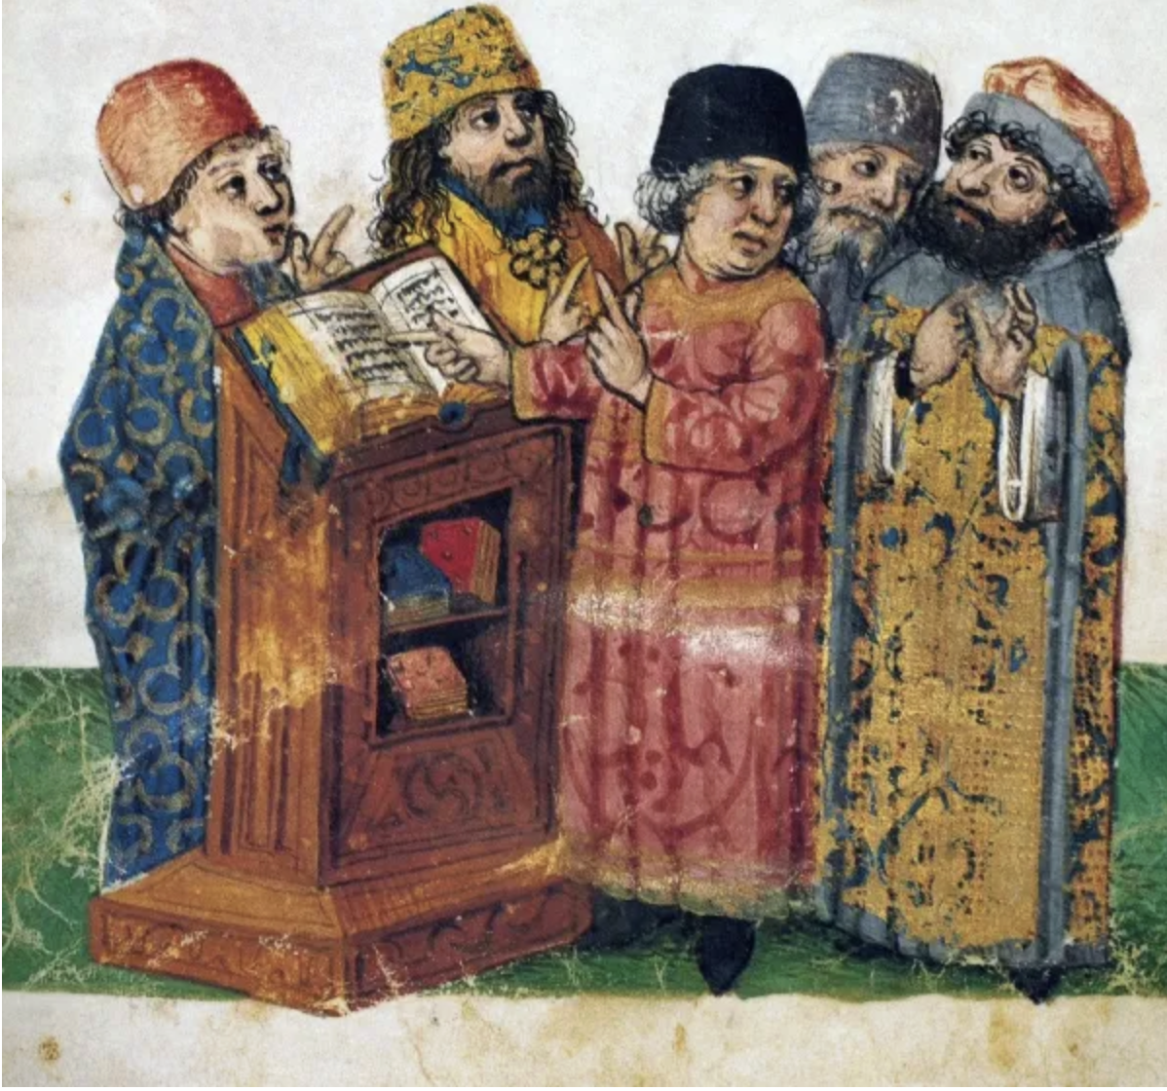
Two Audiences, Two Conversations
An idolator came to Rabbi Yohanan Ben Zakkai while he was teaching his students, claiming a Jewish ritual was a form of witchcraft.
Rabbi Yohanan gave him a reply that satisfied him, and the idolator departed.
Once the idolator had gone, Rabbi Yohanan’s students said to him, “אותו דחית בקנה – אבל לנו, מה תגיד לנו??”
(Numbers Rabba 19:8)
As shlichim, you are asked to hold the internal, family conversation, not the external, defensive argument

Slide 18

Shaliach as Israel Educator
"עֵץ-חַיִּים הִיא לַמַּחֲזִיקִים בָּהּ, וְתֹמְכֶיהָ מְאֻשָּׁר" (Mishlei 3:18).
A tree draws its sustenance from strong, deep roots.
It sends forth its branches ever upward, aspiring to new heights.
And it depends on those who tend and cultivate it — gardeners — to ensure it grows from generation to generation.
This image guides our three-part vision for Israel educators.
We strengthen our roots in the Jewish and Israeli story
We are branches that reach forward as agents of hope
And we model what it is to be a gardener, taking active responsibility for the future of עם ישראל.
·

Slide 19
Shaliach as Israel Educator
Roots: Instilling our students with the history, traditions and texts that comprise the Jewish and Israeli story
Branches: Connecting our students to projects, initiatives, movements that are creating a better future
Cultivating gardeners: Raising students who are active, take responsibility and feel a sense of ownership for the welfare of עם ישראל
·

Slide 20
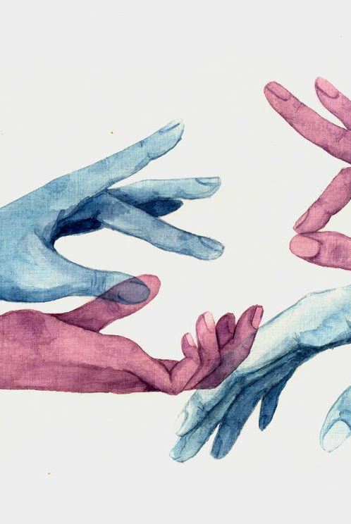
Remember: You’re a Guest
American Jews and Israelis are very different — and that’s OK
Your job is not to convince anybody of anything
→ You are there as a דוגמא אישית – a model of
curiosity, sincerity, authenticity, humanity
→ Be prepared to be a minority!
Take an active interest in the person sitting in front of you
→ Not what they believe, but why
→ Before diving into what they believe, get to who they
are

Slide 21
Thank You!
תודה!

