Slide 1





The Oys & Joys of Working in 🇺🇸
How to lead authentically within “The OJC”
Andrew Keene
+1.414.943.9999
andrewmkeene@gmail.com

Slide 2

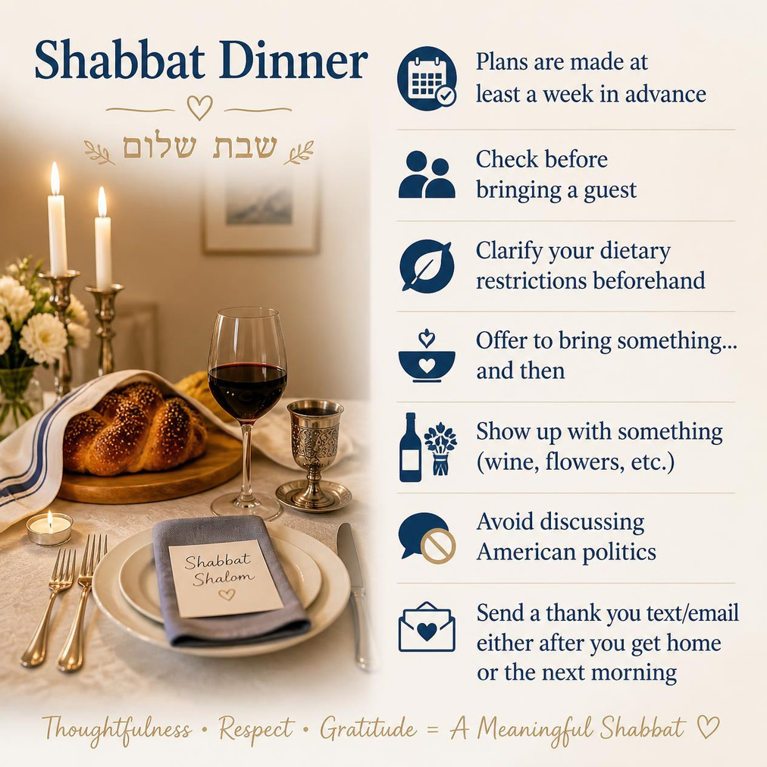

Slide 3
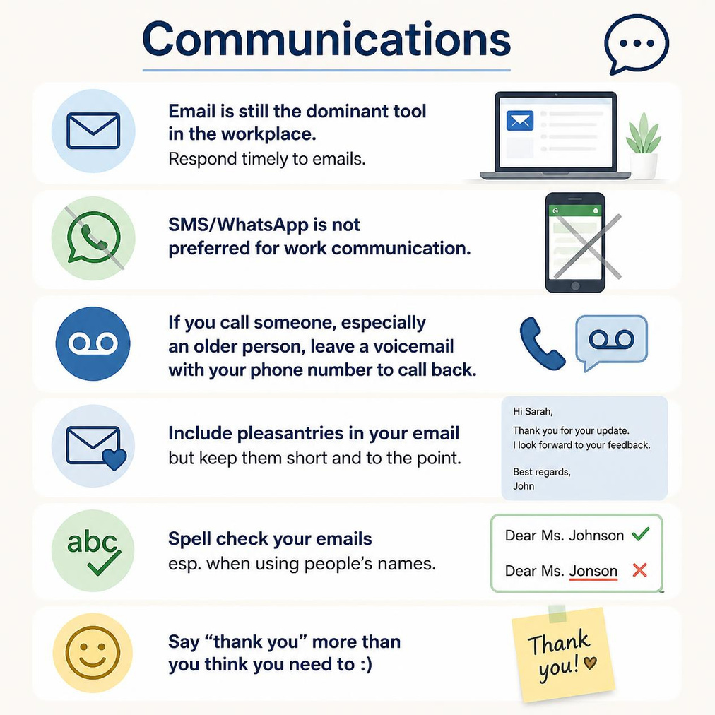

Slide 4


Slide 5
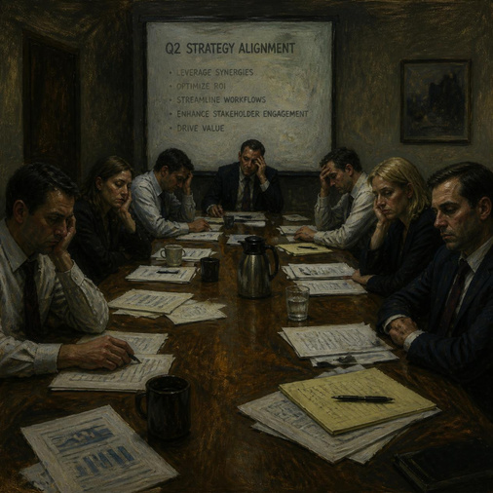
Meetings
  Show up early. Start on time. End on time.
  Check the meeting agenda beforehand. If you’re organizing the meeting, include an agenda/goals.
  Double check that you haven’t excluded anyone from the meeting invite - clarify with your supervisor who should be included. Some meetings should be very small, some should be much larger.
  Come prepared. If it is a group of important stakeholders, consider a slide deck.
  Know what decisions you need to make by the end, assign owners/volunteers, and clarify deadlines.
  Keep your work calendar updated so people can schedule meetings with you easily.
  Try not to interrupt other people or dominate the conversation (even if you are leading it)
  The meeting after the meeting is often where the real work is done.
  Disagree with ideas, not people. (Disagree without being disagreeable)

Slide 6
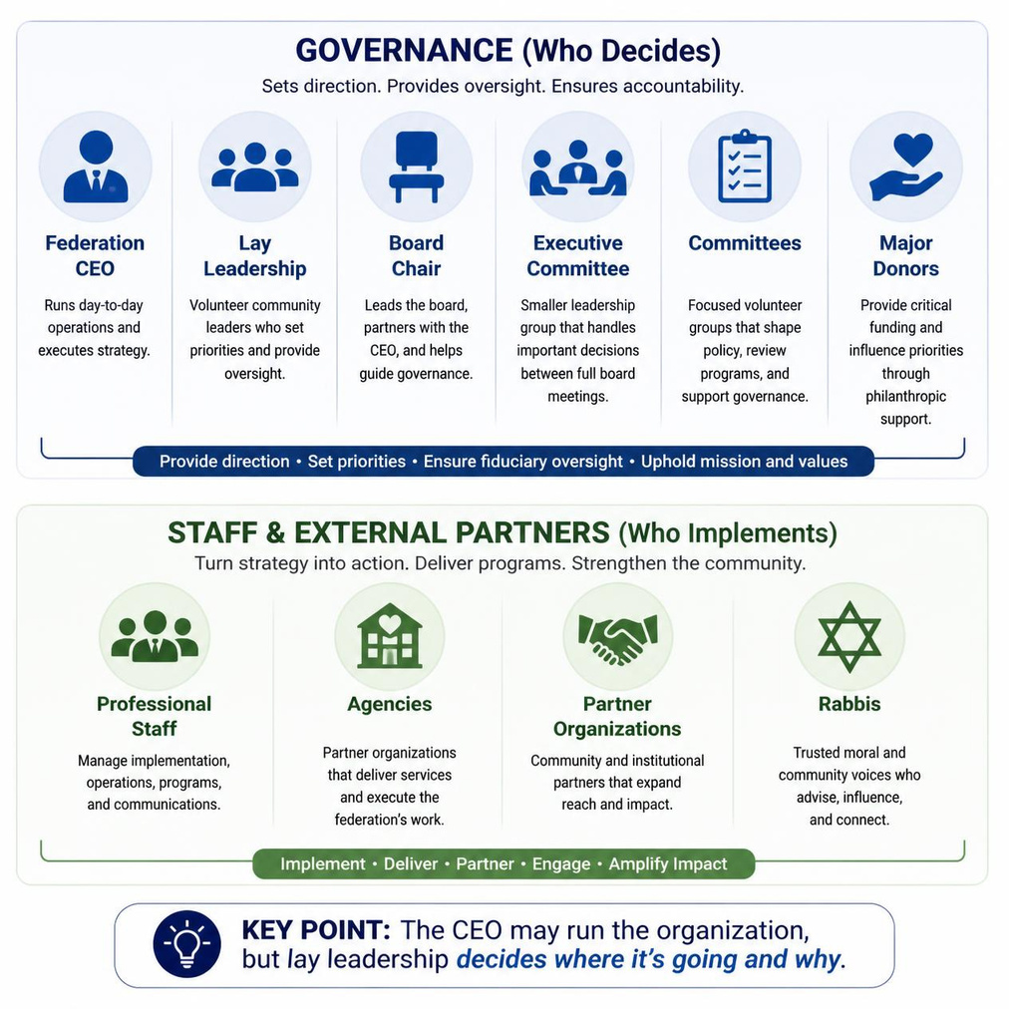
How J. Feds. Actually Work

Slide 7
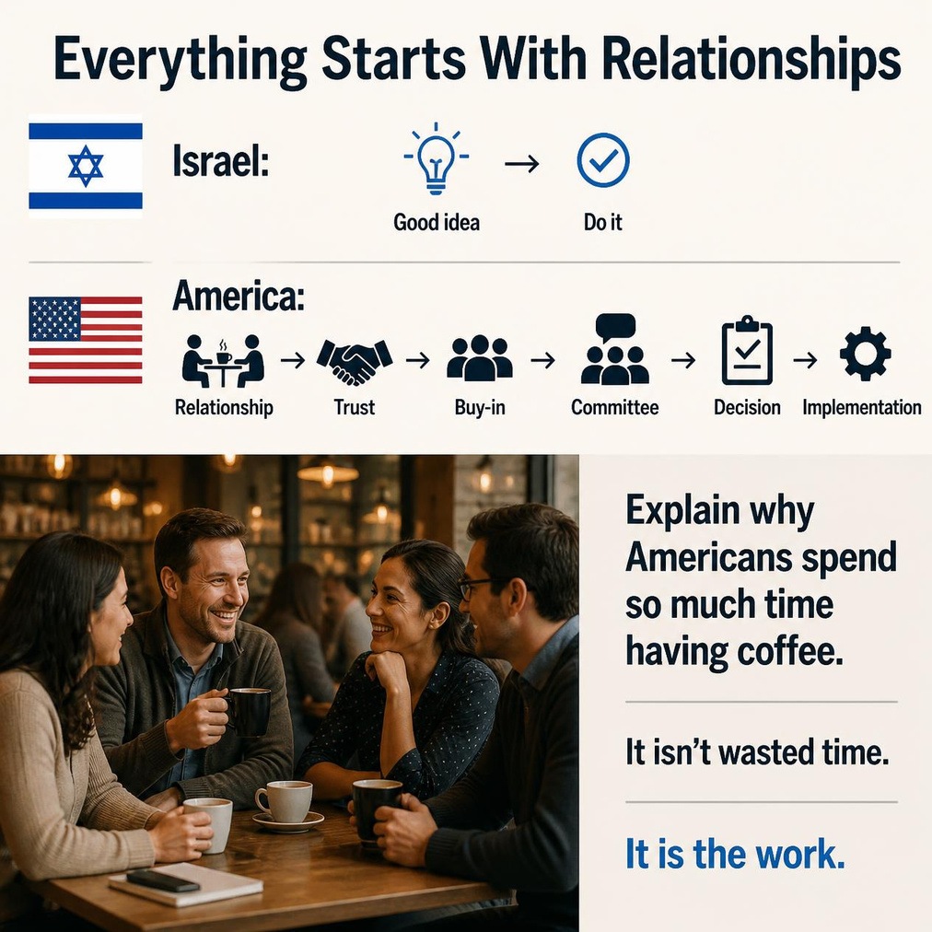

Slide 8
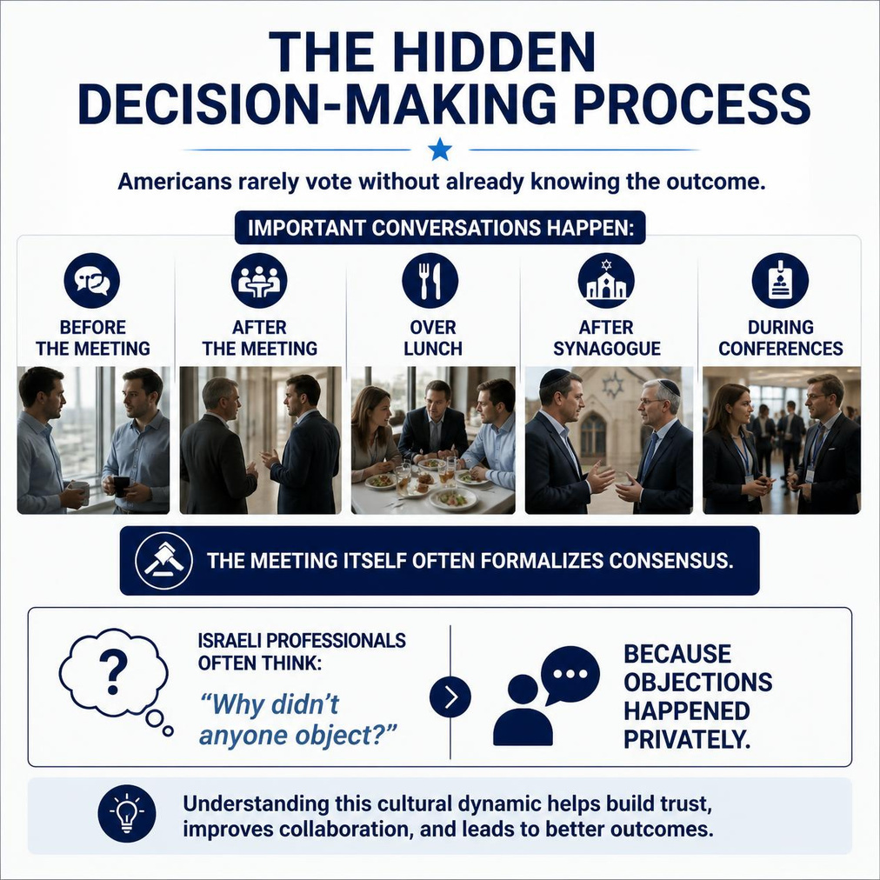

Slide 9
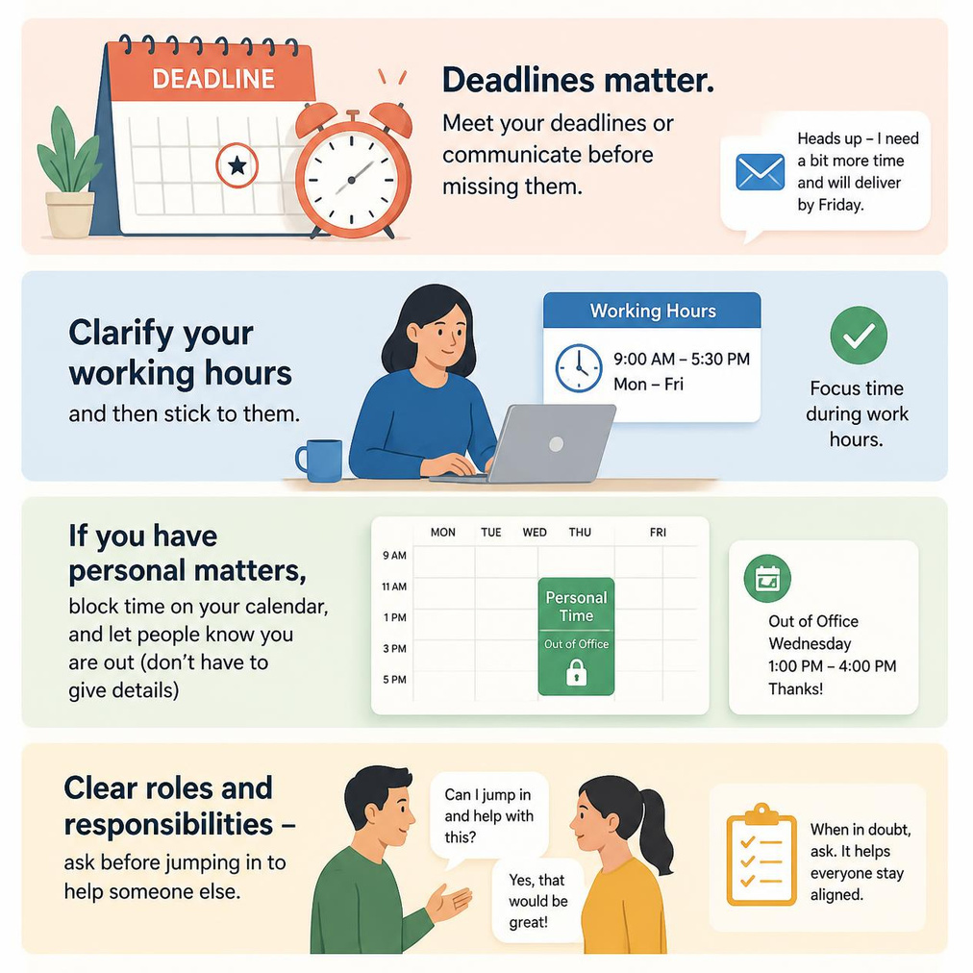
Ways of Working

Slide 10


Slide 11
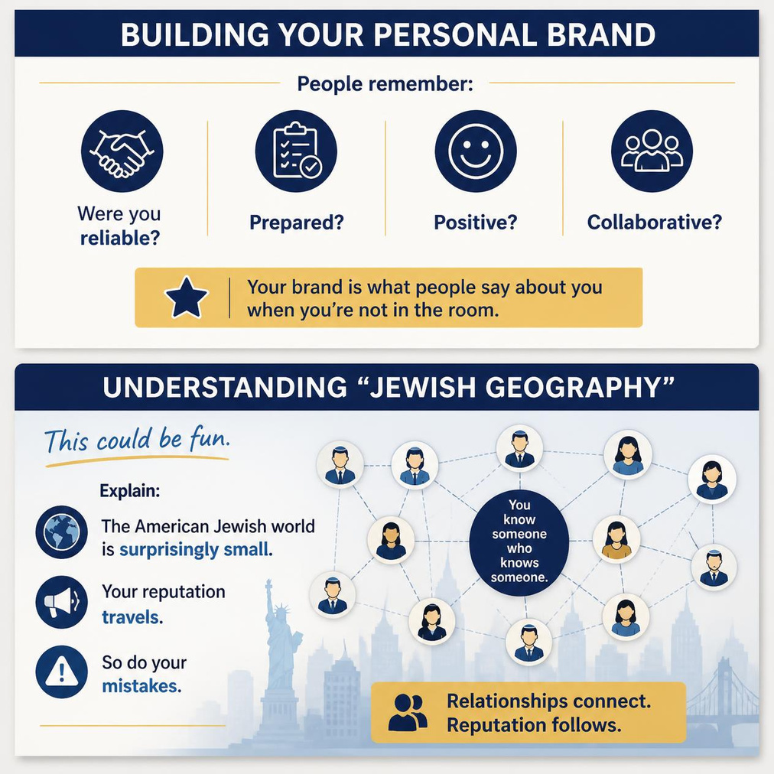

Slide 12


