Slide 1
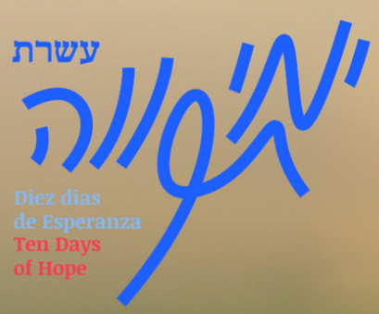

Limud night for October 7th
A program focused on healing, unity, and resilience for Jewish communities following the events of October 7th 2023.
Ten Days of Hope

Slide 2
The Limmud initiative fosters strength and unity among Jewish communities globally.
01
Welcome
It emphasizes the importance of remembering and rebuilding after challenges faced.
02
An introduction to the Limud initiative's significance in Jewish communities around the globe.
Together, we can create lasting change through collaboration and commitment to our values.
03

Slide 3
"Healing begins when we share our stories together."
"Hope is the light that guides us through darkness."
"In unity, we find strength and resilience for our future."
"Together, we can rebuild and create a brighter tomorrow."

Slide 4
Small groups will explore thought-provoking questions to foster dialogue and connection.
01
Guided Reflection
Sharing insights helps us to collectively process our experiences and perspectives.
02
Engage in meaningful discussions around Reflection Prompts for deeper understanding.
This reflective space encourages participants to articulate their thoughts and feelings openly.
03

Slide 5
01
Key note speaker will share his expertise on the situation in Israel.
Expert Conversation
An alumni will discuss their experiences and ongoing projects in the Negev.
02
Join us for a dynamic dialogue and insights from experts.
03
Engage in a Q&A session to deepen understanding and exchange ideas.

Slide 6
Break & Chat
Enjoy light refreshments and engage in meaningful conversations about our next steps.
Join us for a casual break where we will share light refreshments and distribute the “Action Plans” worksheet to discuss and plan our practical next steps for community action.

Slide 7
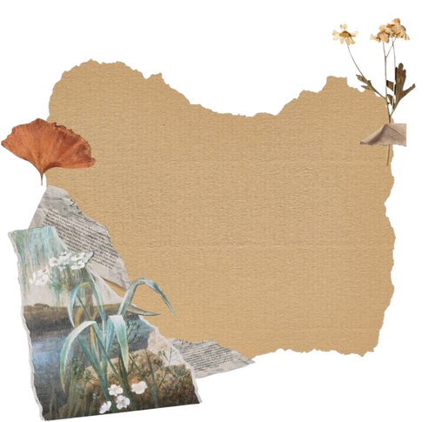

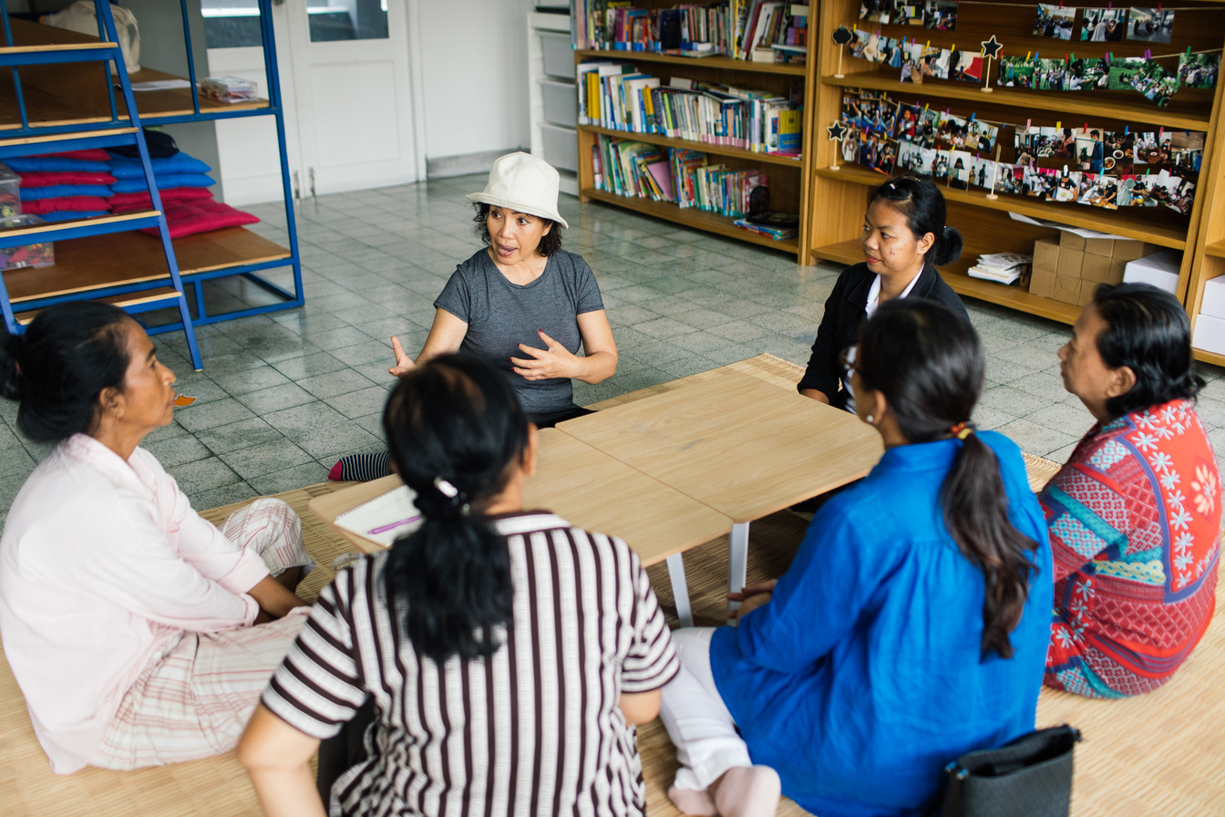
Art & Collage
Create your vision
Creative Workshops
Journal Writing
Reflect on commitment
Engaging Together
Share your stories

Slide 8
The documentary showcases the determination of Kibbutz Be’eri’s residents.
01
Stories of Resilience
Testimonies reveal personal journeys of healing and hope after the tragedy.
02
Witness the strength of community through shared experiences.
Together, we honor their stories and commit to rebuilding for a brighter future.
03

Slide 9
Discussion and Reflection
An opportunity to share thoughts and insights from today's program
  Key takeaways from discussions
  Insights gained from group activities
  Reflections on resilience and community
  Thoughts on future actions and commitments
  Personal stories related to today's themes

Slide 10
01
Participate in the 2-Negev cohort to strengthen connections and support.
Action Steps
Applications for mini-grants are open to fund impactful community projects.
02
Join the “Diaspora-2-Negev” cohort and apply for mini-grants.
03
Together, we can make a difference in rebuilding and healing.

Slide 11
Access educational materials and community programs through our shared resources.
01
Resources
Participate in online discussions and connect with others in the Diaspora community.
02
Explore digital links for further learning and engagement opportunities.
03
Stay updated on events and initiatives by following our social media channels.

Slide 12
From past to future
Join us in a heartfelt group sing-along to foster healing and unity.
Participating in this powerful moment strengthens our commitment to resilience and connection. Together, we will hand out “My Tikkun Pledge” booklets to encourage ongoing engagement and support for rebuilding efforts in our communities.
Ten Days of Hope

