Slide 1
Israel Through Film Burekas Films
Lotem Eilon

Slide 2
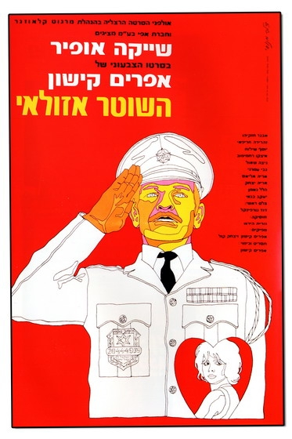
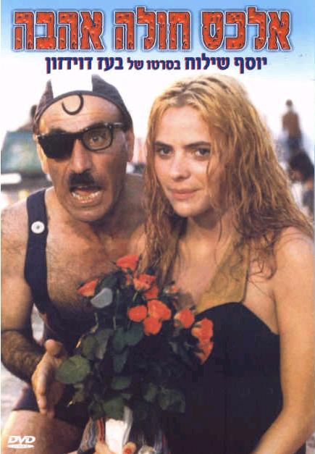
Burekas were a genre of Israeli-made movies popular in Israel in the 1960s and 1970s.
These movies are very popular among Israelis. They were some of the most successful in box office.

Slide 3
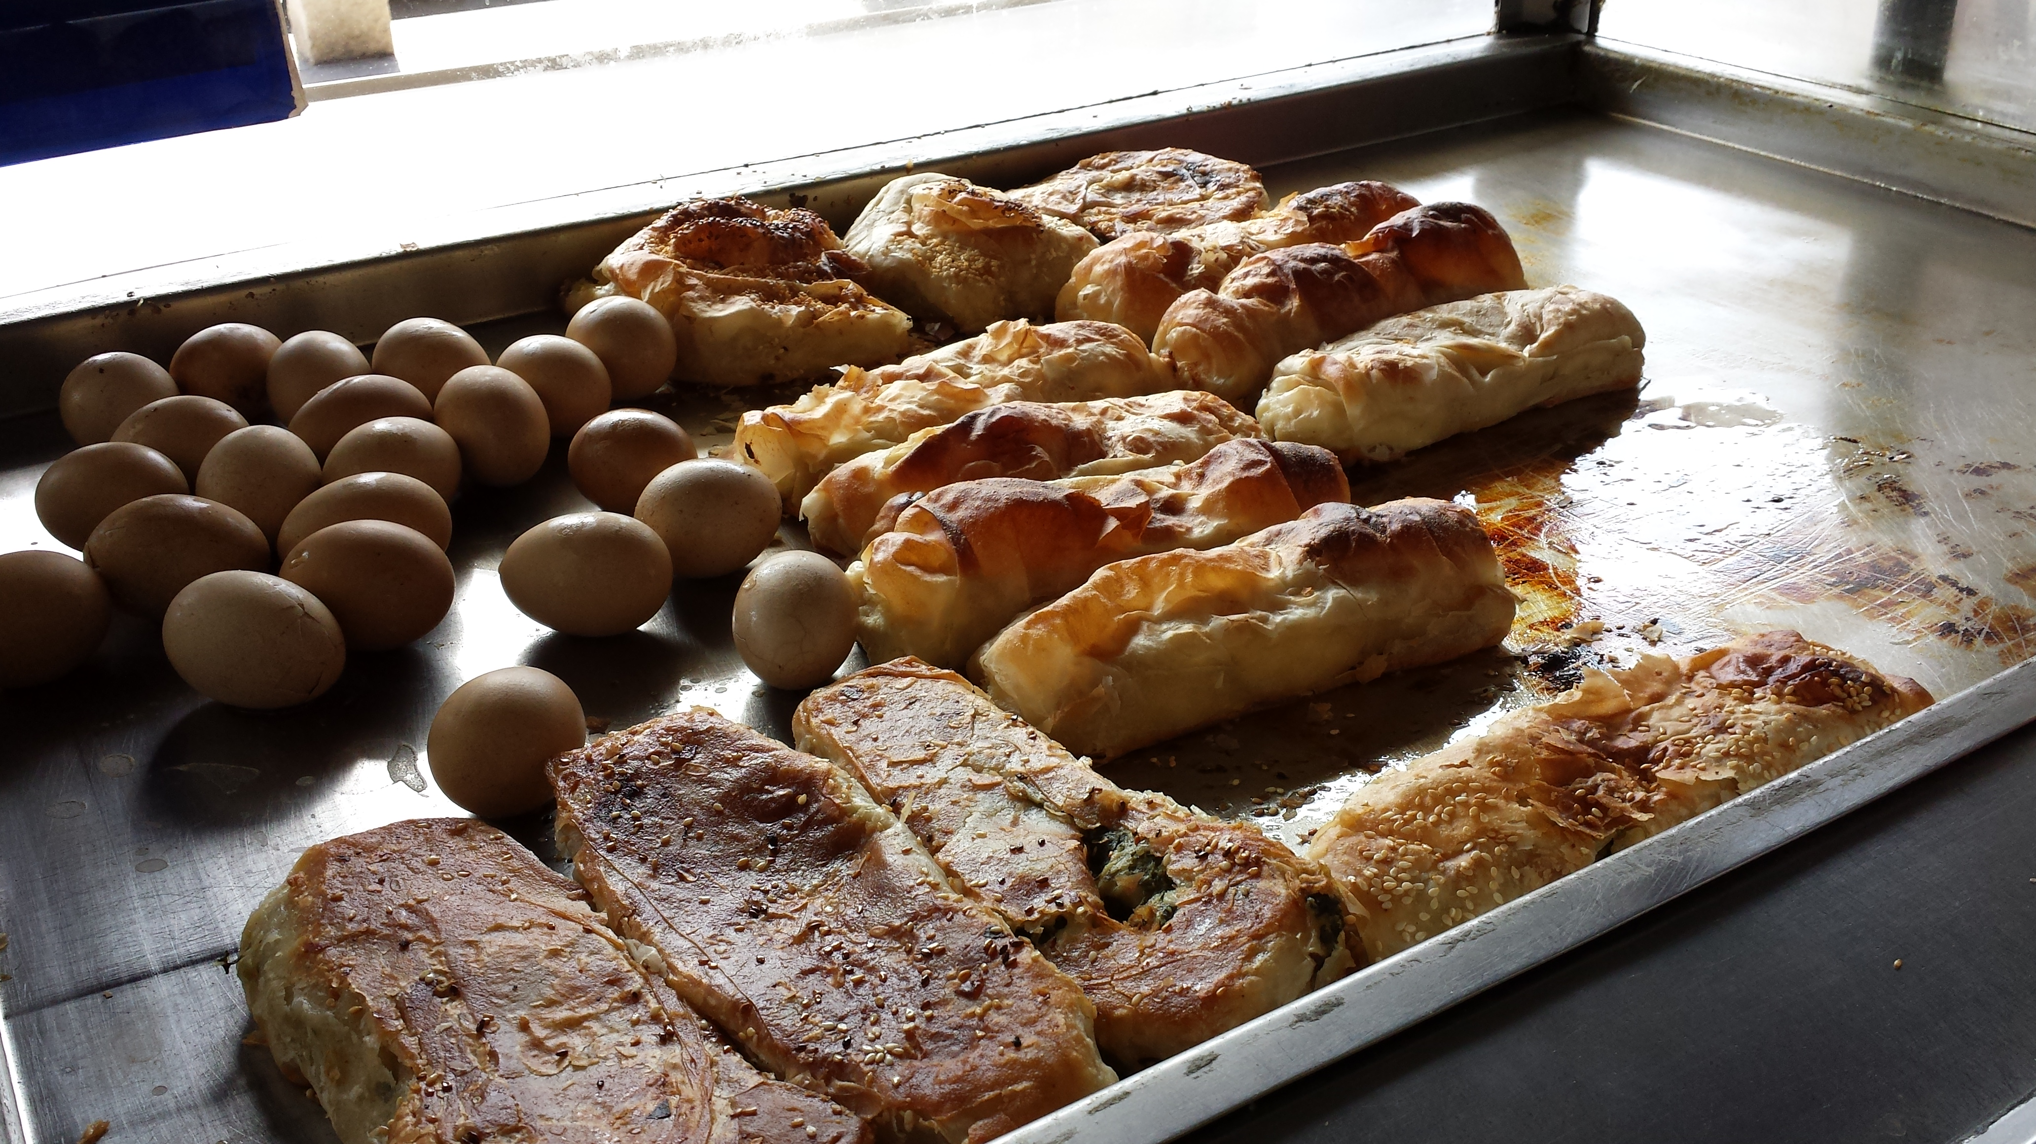
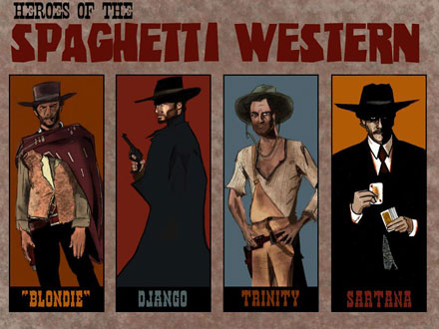
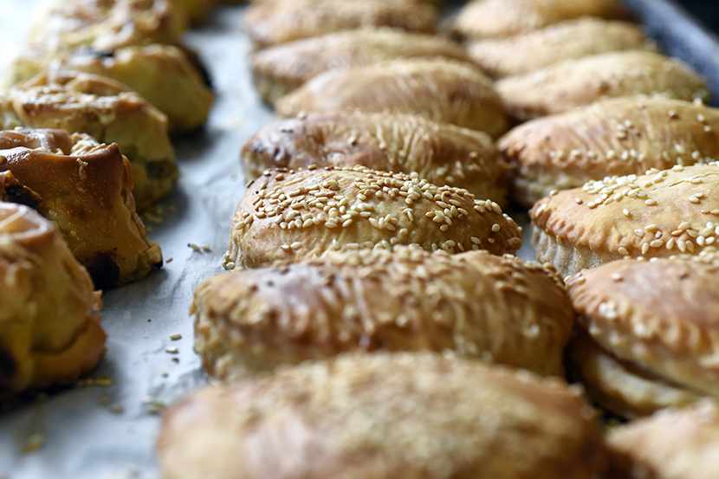
Why “Burekas” Films?
“Spaghetti Western” is a broad subgenre of Western films that emerged in the mid-1960s in Italy.
The term was used because most of these Westerns were produced and directed by Italians
“Burekas Films” is said to have been coined by the Israeli film director who created several such films, as a play-on-words on the "spaghetti western" genre, with the Israeli twist. Bourekas is a notable dish from Israeli cuisine.

Slide 4
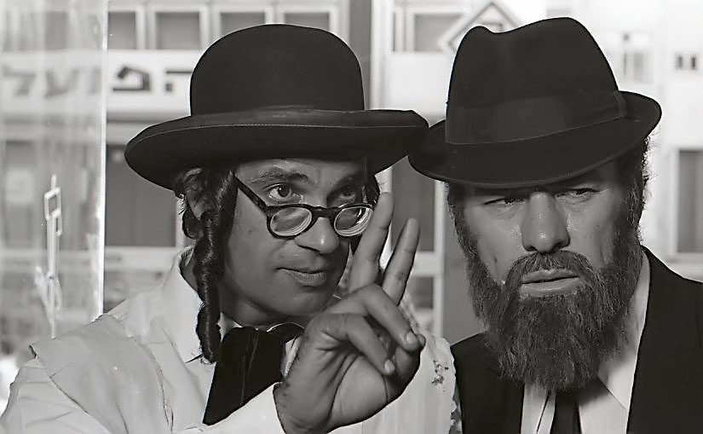
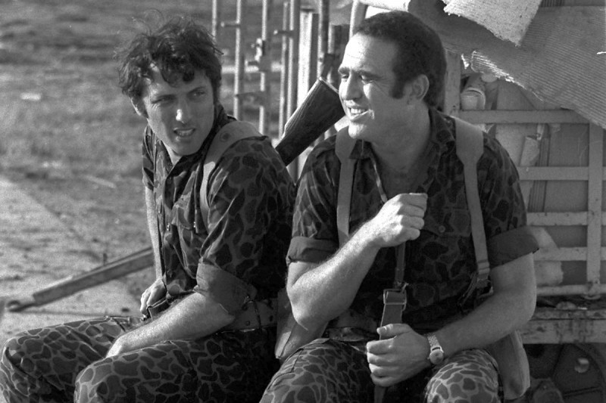
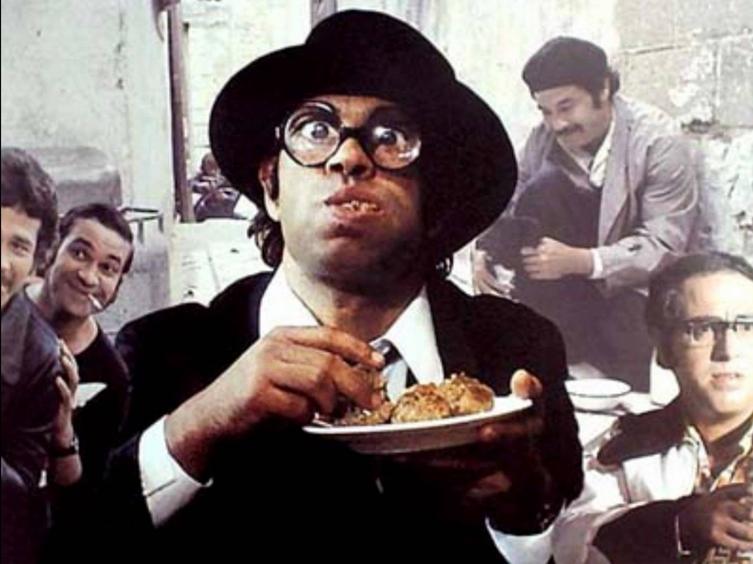
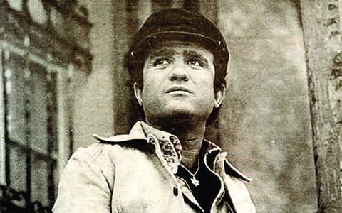
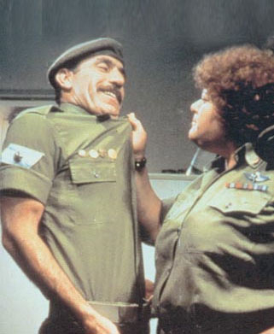
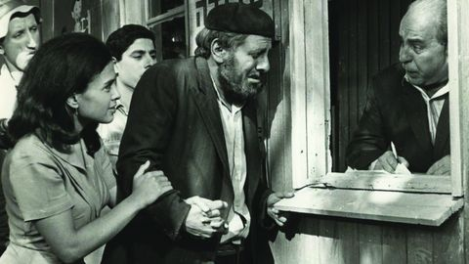
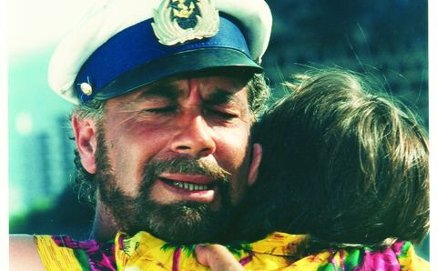
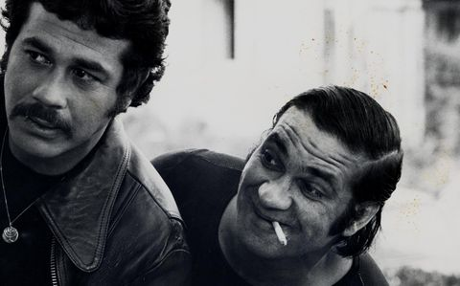
What is special about them?
The main theme in most Bourekas films is the conflict between ethnic cultures in Israel, in particular between the Mizrahi and Ashkenazi Jews.
The hero is usually a Mizrahi Jewish man, almost always poor, canny and with street smarts, who comes into conflict with the institutions of the state or figures of Ashkenazi origin—mostly portrayed as rich, conceited, arrogant, cold-hearted and alienated.
The films portray, in a very comic and fun way, the real struggles and culture clashes Mizrahi Jews experienced in the years following their immigration to Israel.

Slide 5
Chaim Topol as Sallah Shabati

