Slide 1
1948-1952

Slide 2
The Reparations Agreement between Israel and the Federal Republic of Germany was signe. According to the Agreement, West Germany was to pay Israel for the costs of "resettling so great a number of uprooted and destitute Jewish refugees" after the war, and to compensate individual Jews, via the Conference on Jewish Material Claims Against Germany, for losses in Jewish livelihood and property resulting from Nazi persecution.
Public debate was among the fiercest in Israeli history. Opposition to the agreement came from both the right and the left of the political spectrum; both sides argued that accepting reparation payments were the equivalent of forgiving the Nazis for their crimes.
Yaakov Hazan of Mapam said in the Knesset: "Nazism is rearing its ugly head again in Germany, and our so-called Western 'friends' are nurturing that Nazism; they are resurrecting Nazi Germany ... Our army, the Israel Defense Forces, will be in the same camp as the Nazi army, and the Nazis will begin infiltrating here not as our most terrible enemies, but rather as our allies ..."

Slide 3
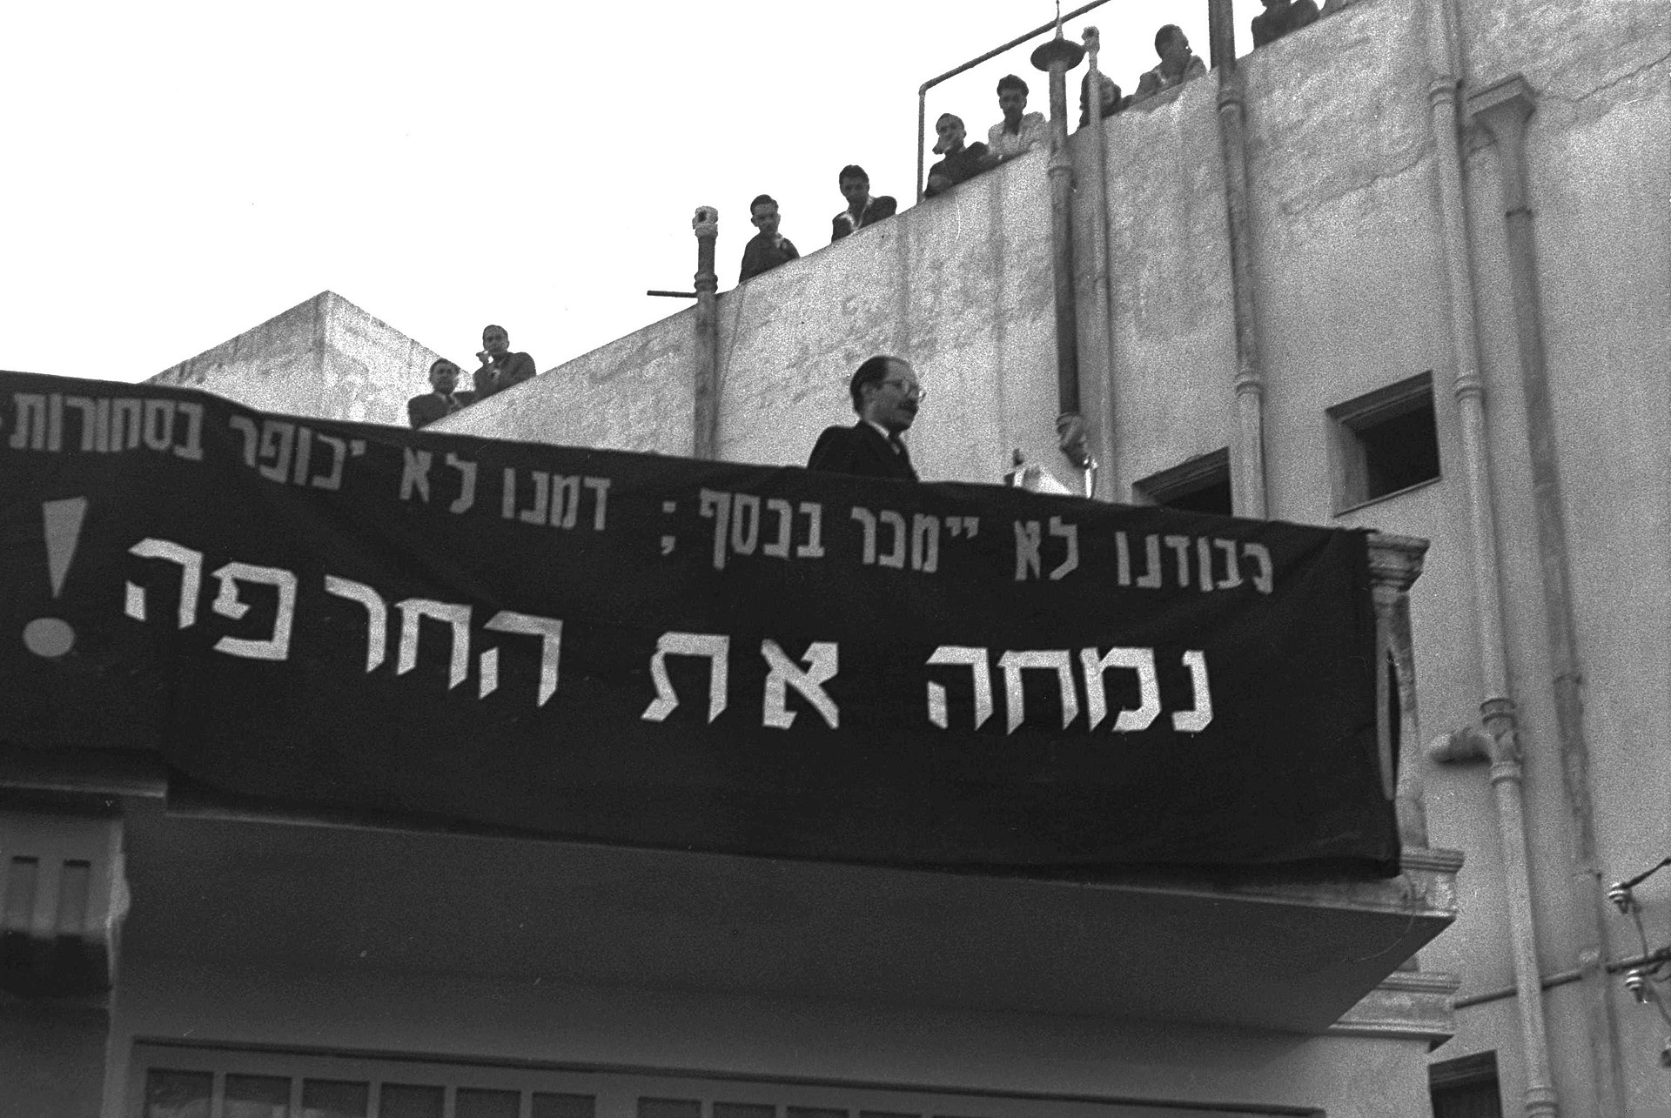

Slide 4
1959

Slide 5
The Wadi Salib riots were a series of street demonstrations and acts of vandalism in the Wadi Salib neighborhood of Haifa, Israel, in 1959, sparked by the shooting of a Moroccan Jewish immigrant by police officers. Demonstrators accused the police of ethnic discrimination against Mizrahi Jews.

Slide 6
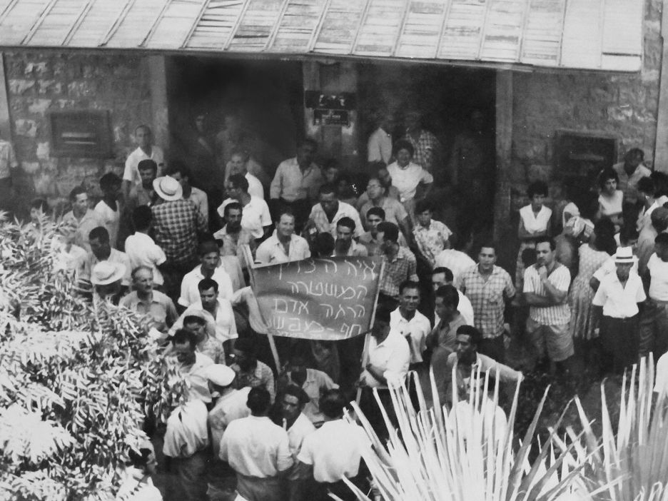

Slide 7
1978

Slide 8
Peace Now was formed during the Israeli-Egyptian peace talks between Israeli Prime Minister Menachem Begin and Egyptian President Anwar Sadat at a time when the talks looked close to collapse.
Three hundred forty-eight reserve officers and soldiers from Israeli army combat units published an open letter to the Prime Minister of Israel. They called for the Israeli government not to squander the historic opportunity for peace between the two nations.
Peace Now held a mass protest in Tel Aviv in order to pressure the government to establish a national inquiry commission to investigate the massacres, as well as calling for the resignation of the defence minister Ariel Sharon. Peace Now's demonstration was attended by 400,000 people, approximately 10% of Israel's population at the time.

Slide 9
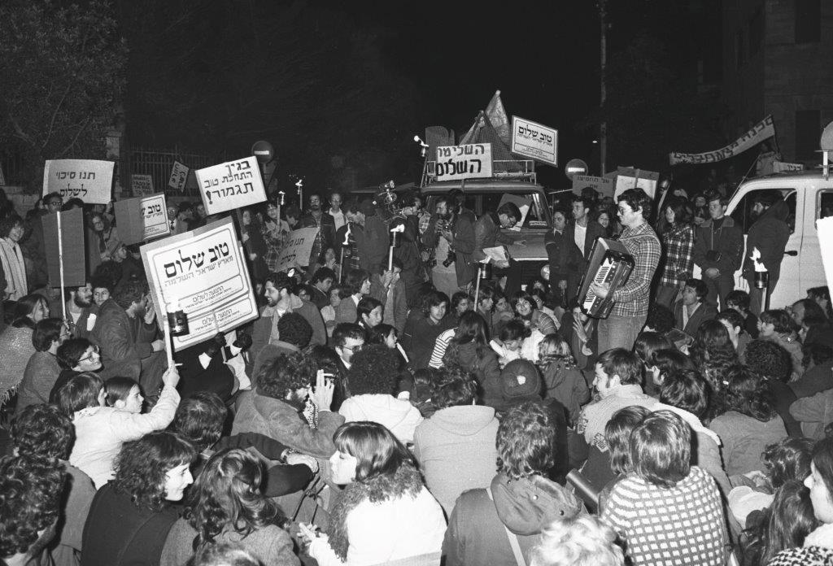

Slide 10
1988

Slide 11
Women of the Wall was founded at the first International Jewish Feminist Conference in Jerusalem. During the conference, Rivka Haut organized a group of multi-denominational women to pray at the Western Wall. 70 women carried a Torah scroll to the Western Wall, and Rabbi Deborah Brin led a prayer service for them.
Since then, the group has faced a legal battle for recognition of their right to pray at the Western Wall. Their presence is deemed offensive by Orthodox worshippers at the site and there have been numerous court proceedings to settle the issue. On the Fast of Esther, a few months after the first p Orthodox men, outraged by the women's singing, hurled chairs and verbal insults at the women, which resulted in the deployment of tear gas to quell the violence.

Slide 12
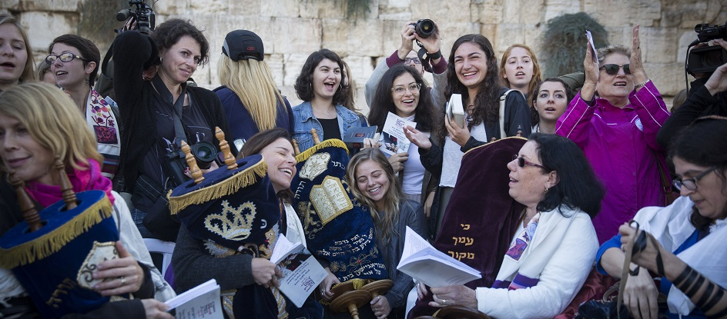

Slide 13
1997

Slide 14
Following the helicopter disaster, killing 73 soldiers from the Nahal Brigade, armored and Engineering fighters (188 Brigade and Battalion 601) and the helicopter crew. four women from Northern Israel, whom were mothers of soldiers who served in Lebanon, Rachel Ben Dor, Miri Sela, Ronit Nahmias and Zahara Antebi, decided to organize protest activities which will call for the unilateral and immediate withdrawal of Israeli forces from Lebanon. The purpose of the movement was to put public pressure on the Israeli government to withdraw from Lebanon, with or without a peace agreement, and thus to implement the United Nations Security Council Resolution 425, calling for the recognition of the territorial integrity and sovereignty of Lebanon, for the IDF to leave the area and the deployment of an international force in the region.

Slide 15
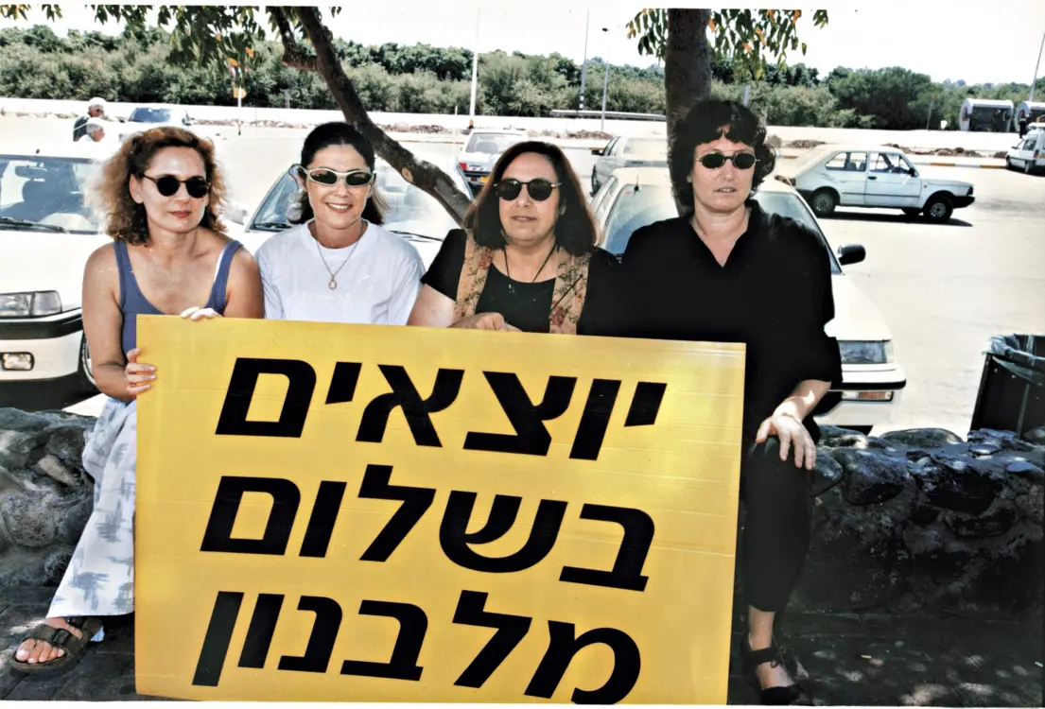

Slide 16
2005

Slide 17
The disengagement plan was first proposed by Prime Minister Ariel Sharon, a long-time advocate for settlements. Sharon argued that in the absence of a serious Palestinian peace partner and amidst ongoing Palestinian terrorism, Israel needed to take unilateral steps to ensure its own security and improve conditions on the ground. the State of Israel “disengaged” from the Gaza Strip, removing all Israeli military installations, 25 Israeli settlements (4 in the West Bank) with over 8,000 residents. The Israel disengagement was unilateral, and was not the result of negotiations with the Palestinians.
Opponents of the plan organized large demonstrations in the period leading up to and during the disengagement, and groups traveled to the Gaza settlements where they staged (primarily) non-violent protests against the evacuations.
Advocates for the plan demonstrated their agreement with the plan in different places around israel.
Public opinion polls showed that the majority of Israelis supported the disengagement. Supporters of the plan argued that this painful move was necessary to protect Israel in the long term. They argued that that the cost of protecting 8,000-plus Israelis living in the midst of one million-plus Palestinians was hurting Israel’s economy and society.

Slide 18
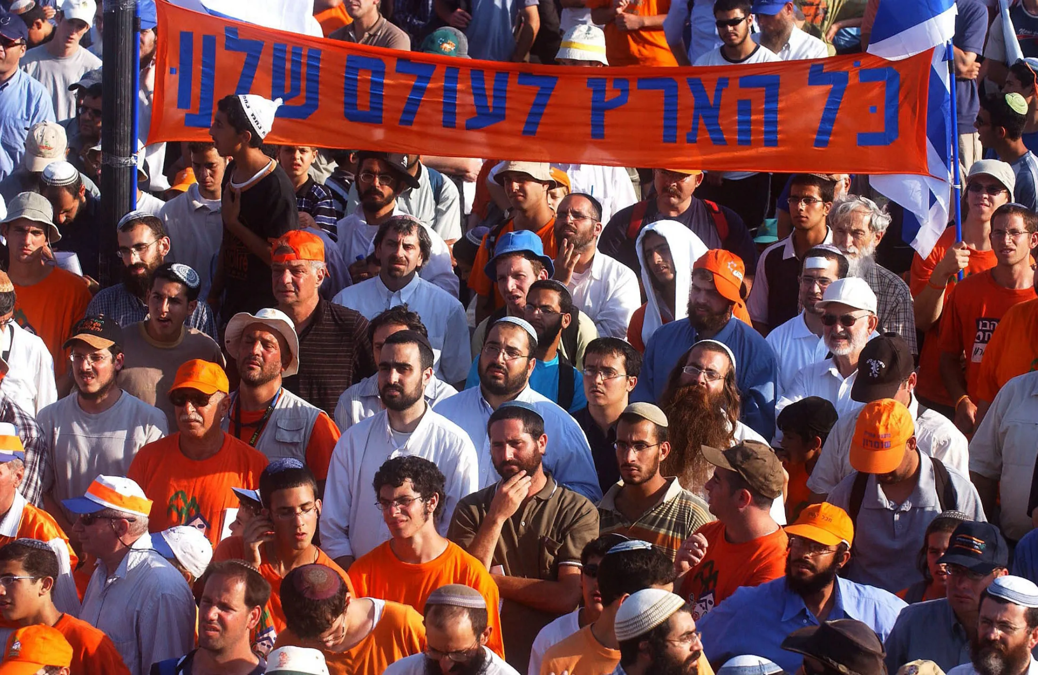

Slide 19
2011

Slide 20
A series of demonstrations in Israel beginning in July 2011 involving hundreds of thousands of protesters from a variety of socio-economic and religious backgrounds opposing the continuing rise in the cost of living (particularly housing) and the deterioration of public services such as health and education. A common rallying cry at the demonstrations was the chant; "The people demand social justice!".
The housing protests which sparked the first demonstrations began as a result of a Facebook protest group that initially led hundreds of people to establish tents in the Rothschild Boulevard in the center of Tel Aviv, an act which soon gained momentum, media attention and began a public discourse in Israel regarding the high cost of housing and living expenses.^{[1]} Soon afterwards, the protests spread to many other major cities in Israel as thousands of Israeli protesters began establishing tents in the middle of central streets in major cities as a means of protest. As part of the protests, several mass demonstrations have been held across the country, in which hundreds of thousands of people have participated.

Slide 21
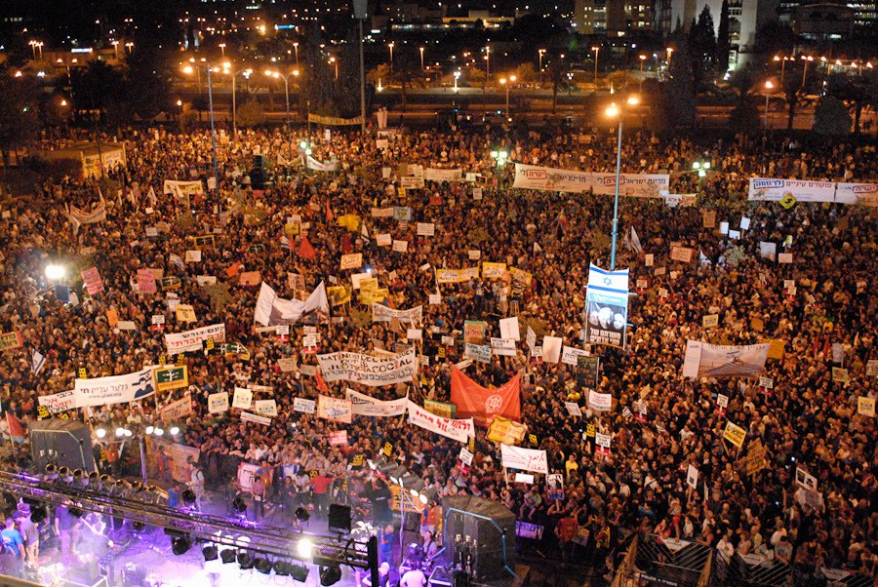

Slide 22
2014

Slide 23
The protest against conscription of yeshiva students was a mass rally held in Jerusalem. Its organizers called for a "million-man protest" against a proposed law overturning the exemption from military service for Haredi talmudical students and criminalizing those who refused to enlist in the Israel Defense Forces. From 300,000 to 600,000 people gathered in one of the largest protests in Israeli history.

Slide 24
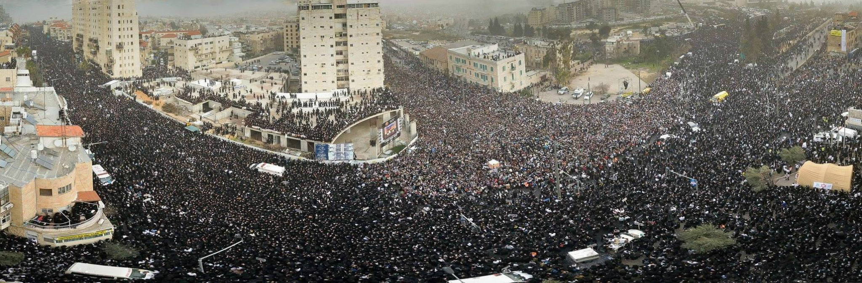

Slide 25
2020-2021

Slide 26
A series of protests against Benjamin Netanyahu, the Prime Minister of Israel, gained prominence in Israel throughout 2020 and 2021, during the COVID-19 pandemic and the ongoing trial of Netanyahu for various corruption scandals. Protesters accused Netanyahu of subjecting the law, as part of his fight in the criminal proceedings against him. The demonstrators protested against Netanyahu's continued tenure in the shadow of his criminal charges, claims of his preference for personal good over the good of the state, and demands to investigate the "submarine affair". One of the hotspots most identified with the protests was the compound near the Prime Minister's Residence, on Balfour Street in Jerusalem. The protests concluded after the thirty-sixth government of Israel, headed by Naftali Bennett and Yair Lapid in a power-sharing agreement, was sworn in on 13 June 2021, ending Netanyahu's 12-year second tenure as prime minister.

Slide 27
