Slide 1
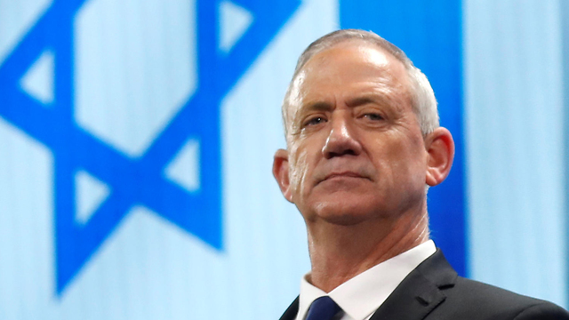
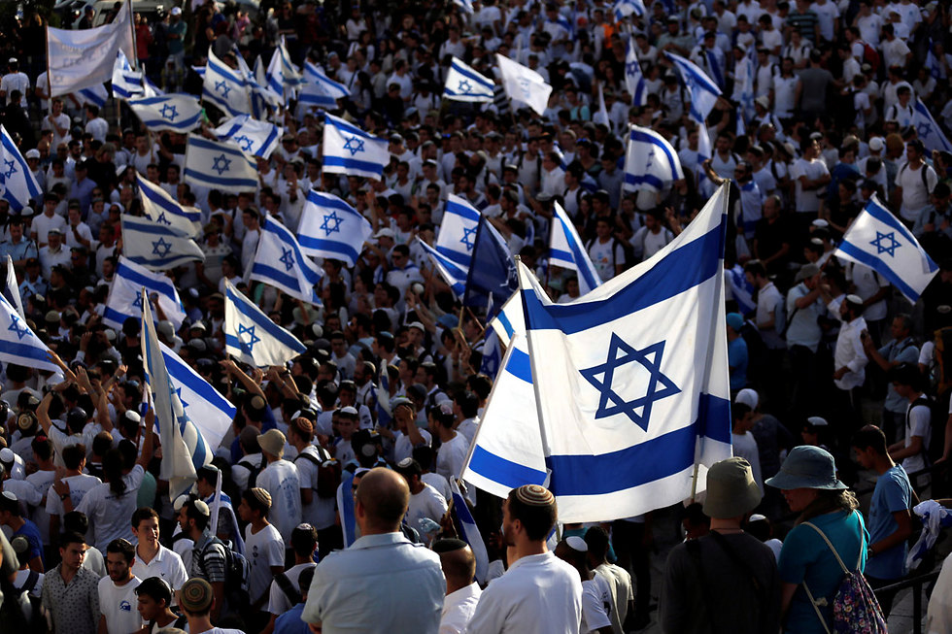
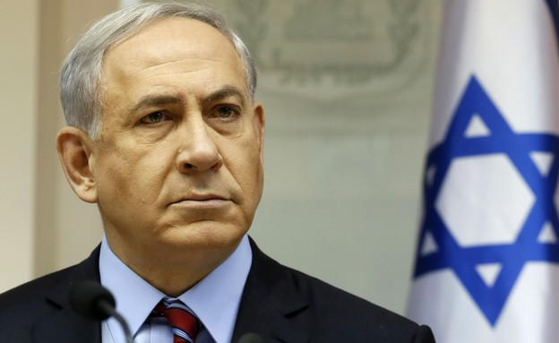
Israeli elections 101
Put together by Gal Malka, Jewish Agency Israel Fellows Educational Director
Edited by Abraham Belilty the community shaliach to shaare torah

Slide 2
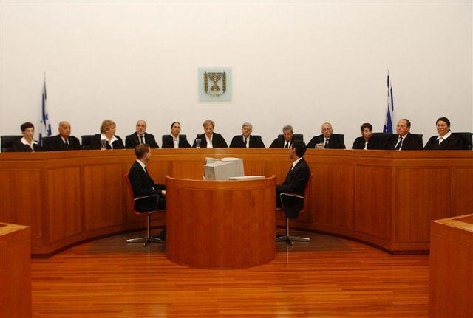
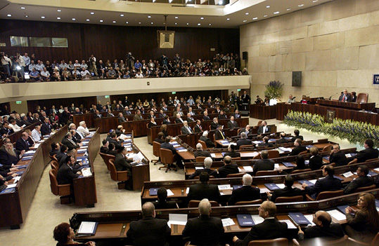
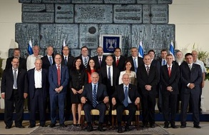
The Israeli Democracy System
Supreme Court Interprets the laws
Separation of powers - a governmental principle according to which the powers of the government must be divided into separate and independent authorities, that balance between them. The purpose of the principle is to prevent a single branch of government from having absolute power.
The Knesset
Determines the laws
The Government
Executes the laws

Slide 3
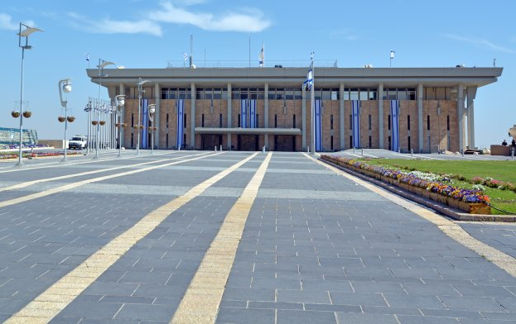
The Israeli Parliament
The Israeli Parliament - House of Representatives, Jerusalem.
The Knesset appoints the government and monitors it. The Supreme court was established by the Knesset law and responsible for interpreting the laws. There is a judicial review of the Knesset's laws.
120 seats (including the prime minister).
Today, 14 parties and 7 more small parties.

Slide 4
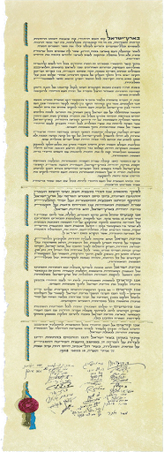
The Israeli Law
The State of Israel’s main principles are set in 12 basic laws (we don’t have a constitution).
Our law is based on Israeli law, and there is a special status for Hebrew law and other religions law.
Israeli law applies to East Jerusalem, with exceptions.
Israeli law applies to the Golan Heights.
Israeli law does not apply in the Gaza Strip and the west bank (the law is based on the Fourth Geneva Convention). Palestinians can petition the High Court of Justice, because it is a right given to anyone who has a legal interest with the State of Israel,

Slide 5
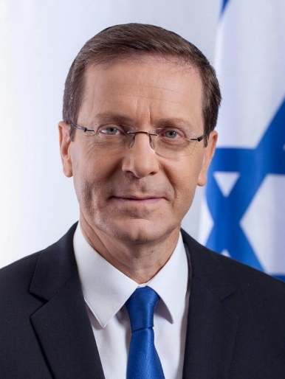
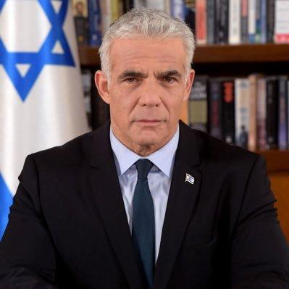
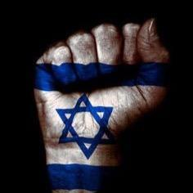
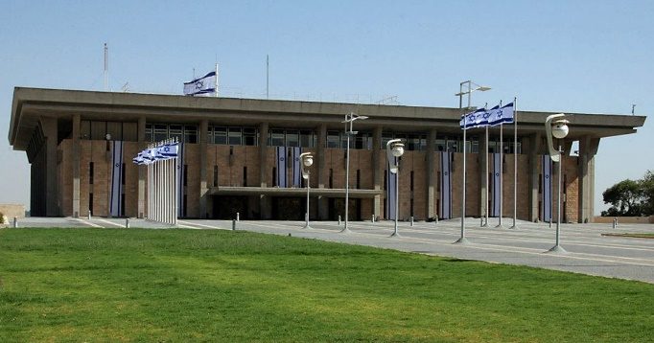
Israel's election process
The People
The Knesset
The President
The Prime Minister

Slide 6
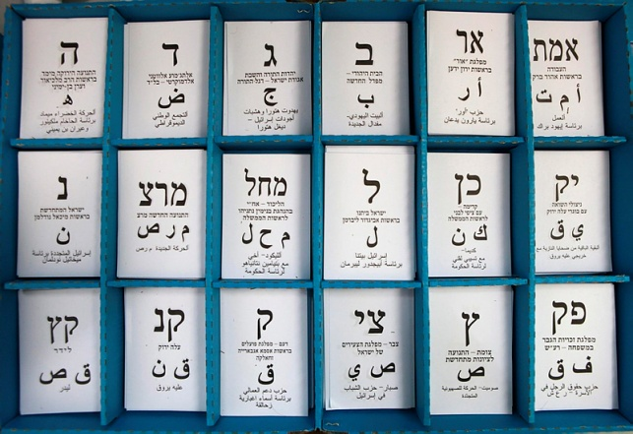
Facts about the Israeli election
Every 4 years / months (almost)
All Israel is a one voting district
Who do you vote for? A party, not a person
Elections threshold – 3.25% of all votes.
Who can vote? Age, citizen, location, soldiers and shlichim.
who can run?
Who picks the Party list? A Leader, Primaries, Committee.

Slide 7
Forming the New Government
STEP 1
After the elections, the President meets with party reps.
Each party recommends a candidate to construct the government.
The president chooses the candidate who is most likely to successfully form a coalition.

Slide 8
Forming the New Government
STEP 2
The candidate has 29 days to form a government (possible 14 days extension).
If after 42 days he fails to form a government, the president gives a second candidate the option to do so.
After another 42 days – Another around or election.

Slide 9
Building a Coalition
Negotiations begins.
The goal – Majority of seats (61 minimum).
Each potential partner party present its’ demands as far as roles in the government, agenda etc.
Once negotiations are over – the government is sworn into office.
Who ever disagree to collaborate with the new Prime Minister – will be in the opposition.

Slide 10
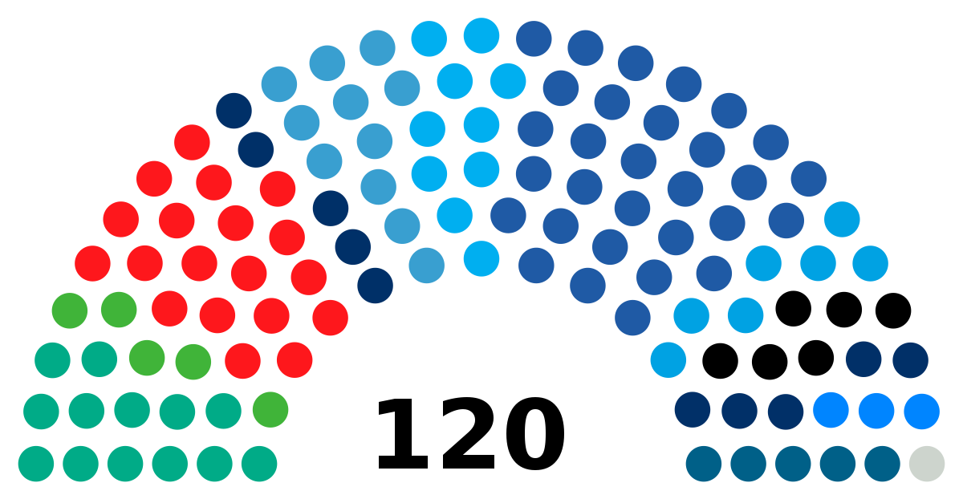
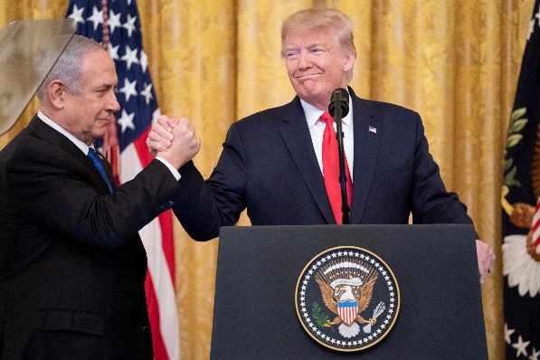
The main issues for this election
“Just not Bibi”
Government Stability
“Peace to Prosperity”

Slide 11
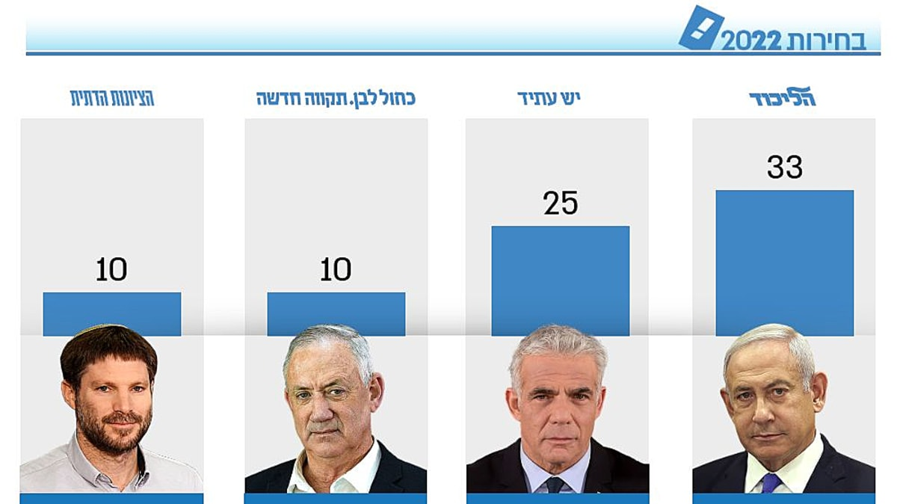
The Parties

Slide 12
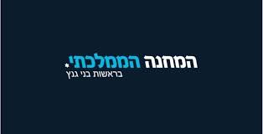
National Unity Party המחנה הממלכתי
An Israeli political alliance made up of Benny Gantz’s Blue and White party and Gideon Sa'ar’s New Hope party, as well as former IDF Chief of Staff Gadi Eizenkot.
The alliance was created to participate in the 2022 Israeli legislative election.
Main policy issues: 2 states solution, State- Church, the costs of living, education, Limiting the term of office of the Prime Minister and the number of ministers.
Current Mandate Status:
Gantz (Kachol Lavan): 8
Saar (Tikvah Hadasha): 5
Expectations of mandates: 13
Left
Right
Social-democratic
Capitalistic
Peace
Security
State
Church

Slide 13
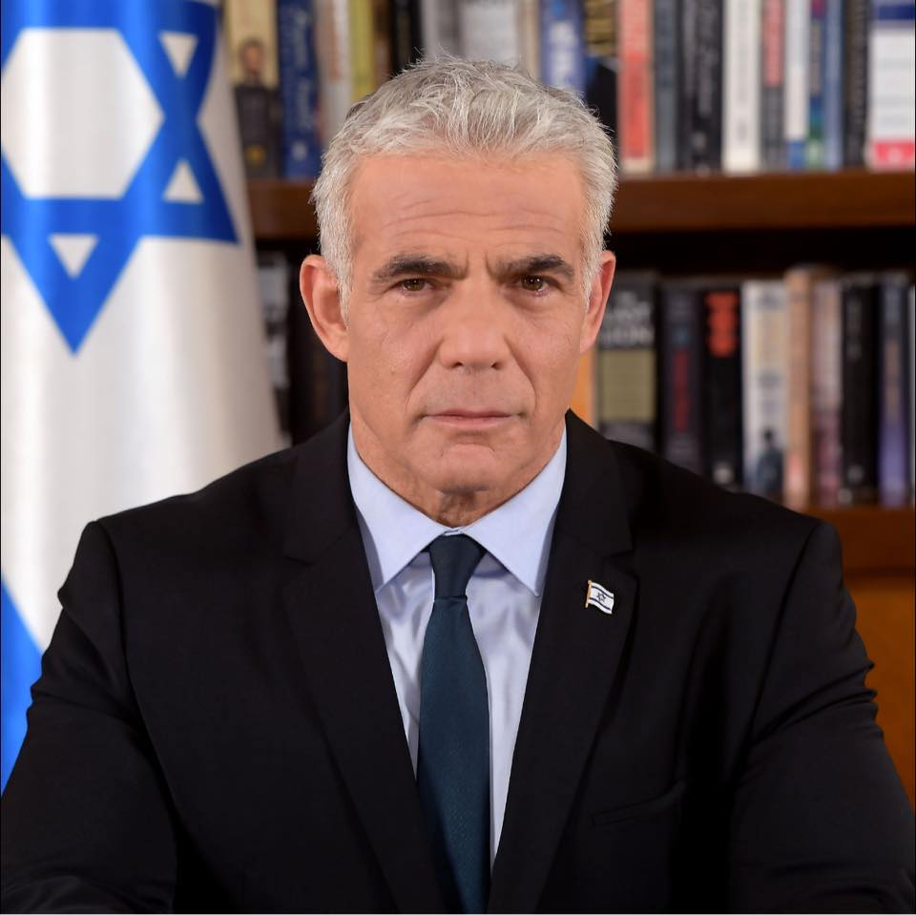
There is Future יש עתיד
Yair lapid is the prime minister of Israel.
Yesh Atid- there is a future, is a party that promotes equality, in military drafting in taxes, in adoption and other services for lgbtq citizens and gender equality.
They are promoting limiting the term of a prime minister and up to two terms (8 years)
Current Mandate Status: 17
Expectations of mandates: 24
Left
Right
Social-democratic
Capitalistic
Peace
Security
State
Church

Slide 14
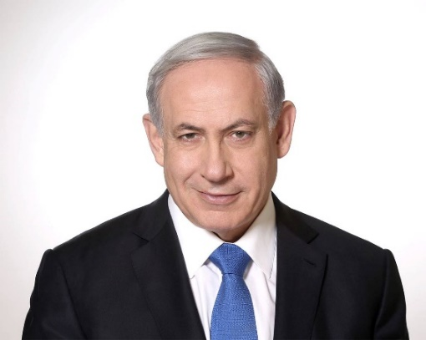
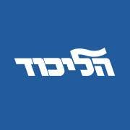
LIKUD - הליכוד
The biggest party since 2009 The head of the party is in the midst of criminal proceedings, and he will start his trial after the election.
Rights for the LGBTQ community?!
As for 2/26/2020 the party expressed support for Cannabis legalization
Current Mandate Status: 30
Expectations of mandates: 33
Left
Right
Social-democratic
Capitalistic
Peace
Security
State
Church

Slide 15
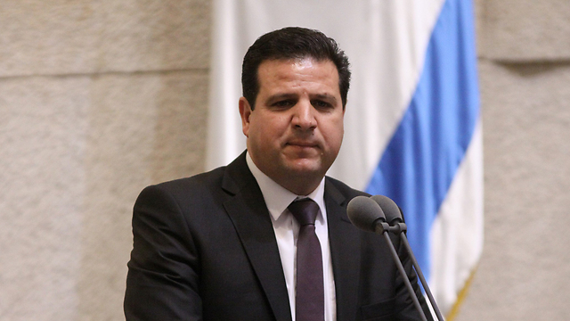
Hadash-Taal – חד”ש -תע”ל
A political alliance of 2 Arab parties - Hadash and Taal.
Joint list are was a wide large party that had representation from the third arab party called Raam
The list is ideologically diverse and includes communists, socialists, feminists, Islamists, and Palestinian nationalists.
Current Mandate Status: 6
Expectations of mandates: 4
Left
Right
Social-democratic
Capitalistic
?
Peace
Security
?
State
Church

Slide 16
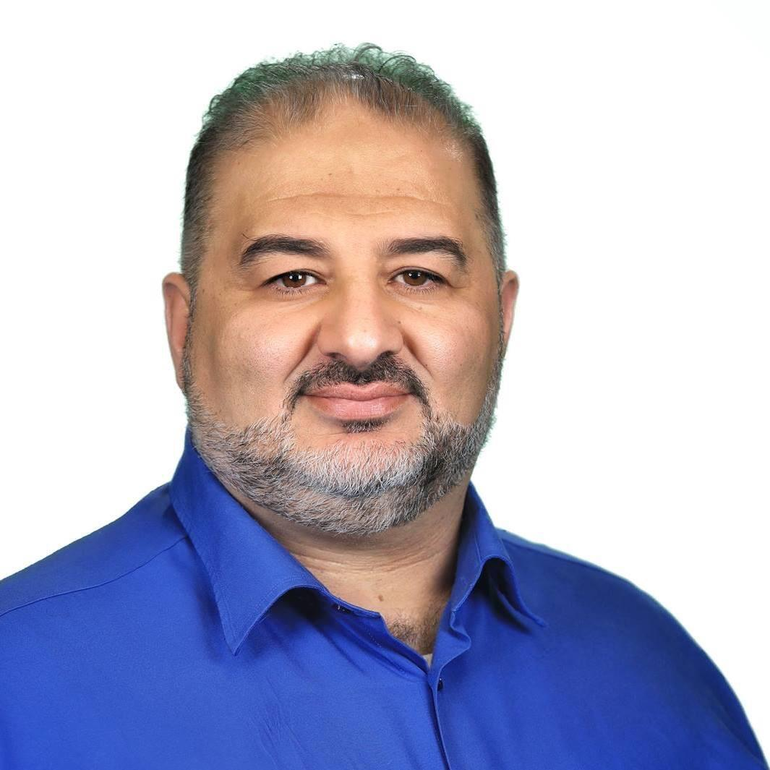
Raam - רע”ם
Raam- stands for- joint arab list. The party is islamic oriented and belive in islam rule over the palestinians. Also believes in a 2 state solution
The arab party that was offered before to become a part of a right wing government later on agreed to be part of the coalition of yesh atid. Raam is the first arab party to be part of a coalition
The party has critics from both plaestinian and israeli, right and left.
Current Mandate Status: 4
Expectations of mandates: 4
Left
Right
Social-democratic
Capitalistic
?
Peace
Security
?
State
Church

Slide 17
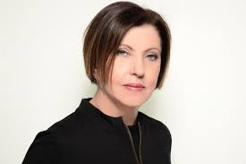
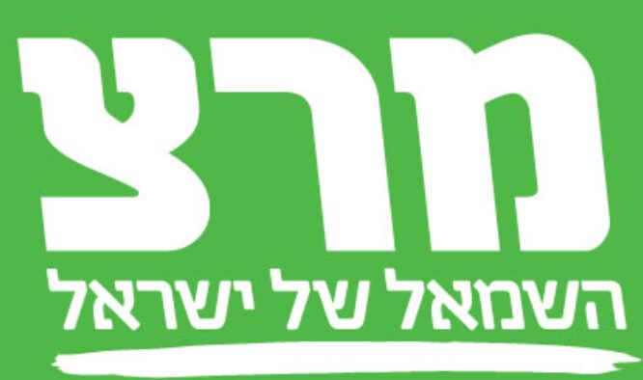
Meretz (“Israel’s Left”) מרצ
Far left, Zionist, socialist, progressive party
Emphasize peace with the Palestinians, human rights for ethnic and sexual minorities, and environmentalism
Two states solution - Dismantling most Israeli settlements in the West Bank and struggle for the protection of human rights in the Israeli-occupied territories
Meretz calls on the world to recognize a Palestinian state, without negotiations with Israel and even against its consent.
Promotes separation of religion and state
Current Mandate Status: 5 Expectations of mandates: 5
Left
Right
Socialist
Capitalist
Peace
Security
State
“Church”

Slide 18
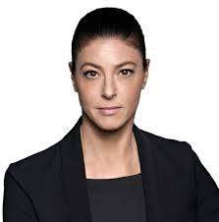
Labor– העבודה
Labor - For years the party has been suffering from internal instability (since Rabin's assassination), for the secong time Merav Michaeli is leading the party. Bringing it back to its historic good path.
Promoting gender equality, have been the first party to have a reform rabbi in the knesset
Democratic party
Current Mandate Status: 7 Expectations of mandates: 5
Left
Right
Social-democratic
Capitalistic
Peace
Security
State
Church

Slide 19
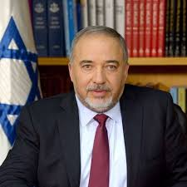
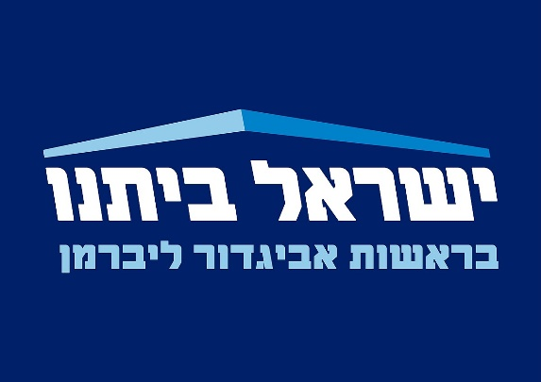
Israel Our Home– ישראל ביתנו
A secularist and right-wing nationalist political party, and Russian-speaking Israelis.
Lieberman was the Minister of Defense. He was resigned due to disagreements with Netanyahu. Some argued that this is one of the main reasons for first elections of the year.
Liberman is one of the most important people in the Israeli politics. He had and still have the power to decide what will happen in less than a week.
Current Mandate Status: 7
Expectations of mandates: 5
Left
Right
Social-democratic
Capitalistic
Peace
Security
State
Church

Slide 20
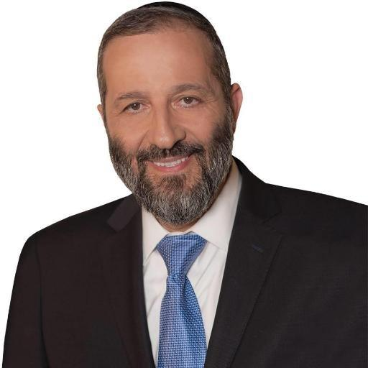
Torah-Observant Sephardim – ש"ס
An Ultra-Orthodox religious political party in Israel.
Founded in 1984 under the leadership of Rabbi Ovadia Yosef, a former Israeli Sephardi chief rabbi and its spiritual leader until his death.
It primarily represents the interests of Haredi Sephardic.
Many of its voters are Modern Orthodox and traditional Mizrahi and Sephardi Jews, because its effort to prevent discrimination between Ashkenazi to Sephardi .
Deri was convicted of taking bribes while serving as Interior Minister, and was given a three-year jail sentence.
Current Mandate Status: 9
Expectations of mandates: 8
Left
Right
Social-democratic
Capitalistic
Peace
Security
State
Church

Slide 21
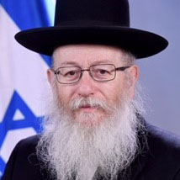
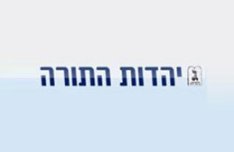
United Torah Judaism – יהדות התורה המאוחדת
United Torah Judaism is a coalition of two ultra-Orthodox parties, Agudat Israel and Degel HaTorah.
A Ashkenazi and Haridi party.
In the past, the two parties did not appoint ministers on their behalf in the government, but only deputy ministers, so as not to take responsibility for government actions. The head of the party become a minister necasue Netanyahu criminal case.
Litzman, is popular in secular Israeli society as deputy health minister (among other things, because of his support for civilization).
Current Mandate Status: 7
Expectations of mandates: 7
Left
Right
Social-democratic
Capitalistic
Peace
Security
State
Church

Slide 22
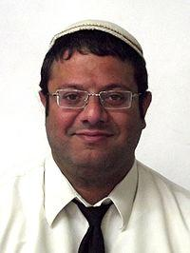
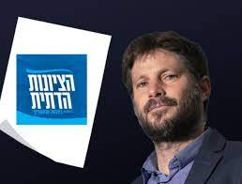
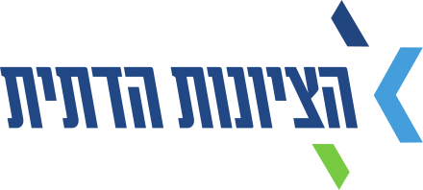
Jewish Power – הציונות הדתית
Far right wing, Religious Zionist.
One state solution, complete Israeli rule of the land between the river to the sea.
Equality between the religious and secular education system.
Left
Right
Social-democratic
Capitalistic
Peace
Security
State
Church
Current Mandate Status: 7
Expectations of mandates: 13

Slide 23
That’s it?
6,453,255 people have the right to vote.
350,000 Votes (9-10 seats) will be lost because the method.
This situation led to many parties' connections

Slide 24
What Israeli’s think about it?
No trust in the government
Some care about basic issues (health, transportation)
Some want to replace Bibi
Some care about security and international relations
Hate, Incitement, lack of unity

