Slide 1
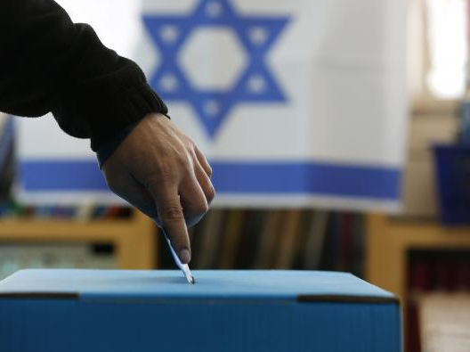
Israeli Elections 2021 4th election within two years

Slide 2
The Israeli democracy system
How did we end up with 4 elections in 2 years?
The different political parties and new players
Open discussion and questions

Slide 3
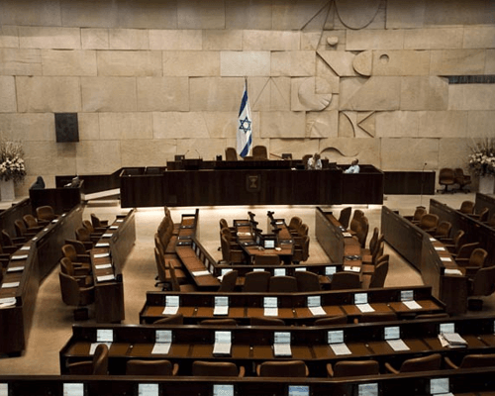
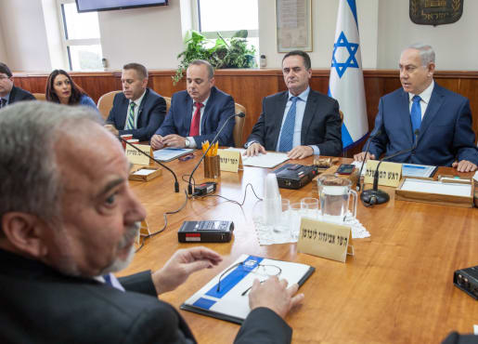
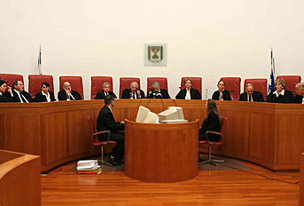
Israel is a parliamentary Democracy
Separation of powers – three independent authorities with balance between them
Prevents a single branch to have absolute power
The Knesset determines the laws
The government executes the laws
The Supremecourt interprets the laws

Slide 5
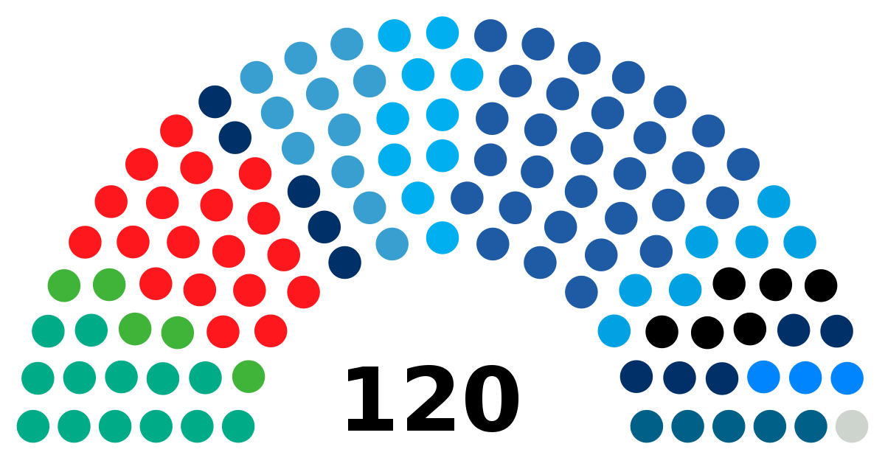
The Elections Process
The elections are held every 4 years (almost)
Voting for a list and not for an individual candidate.
Proportional representation
Who can vote? Israeli citizens over the age of 18
Who can run for office? 21+
Who determents a party’s list of representatives? Leader/ primaries/committee

Slide 6
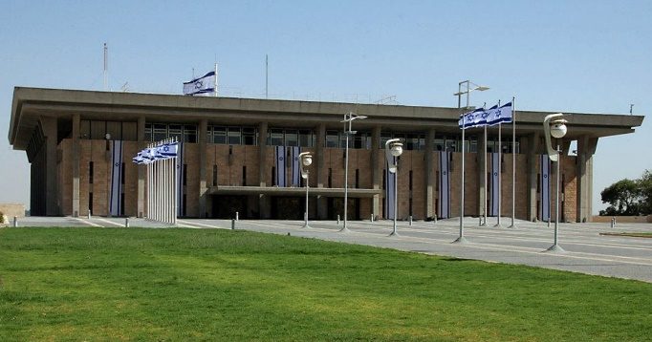
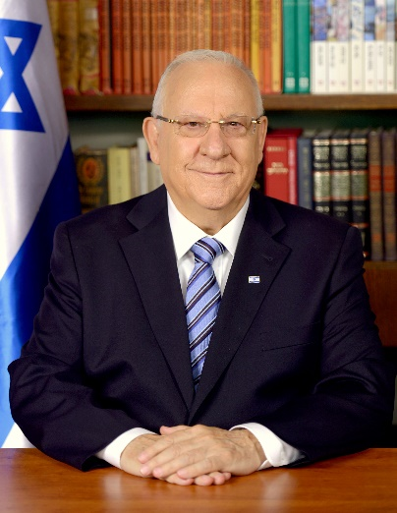
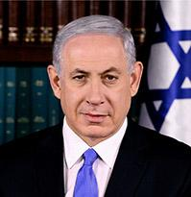
Israel's election process
The People
The Knesset
The President
The Prime Minister

Slide 7
20th Knesset
dissolved December 2018
April 2019 election for 21st Knesset
21st Knesset
dissolved May 2019
September 2019 election for 22nd Knesset
22nd Knesset dissolved December 2019
March 2020 election for 23rd Knesset
23rd Knesset dissolved December 2020
March 2020 election for 24th Knesset
Notes:
The 2019–2020 Israeli political crisis began after the elections of April 2019 left no party able to form a government. The two major parties, Blue and White and Likud, received an equal number of 35 seats. The Likud received a mandate from the president to attempt to form a government, but Chairman Benjamin Netanyahu of the Likud party failed to arrange a majority coalition of 61 seats. The Knesset was dissolved shortly thereafter.^{[1]}
A second election was held in September 2019. This time, Blue and White overcame the Likud by a single seat. Nonetheless, the Likud received the mandate from the president after gaining the support of one Knesset member more than Blue and White. Netanyahu again failed to form a government,^{[2]} but this time he could not dissolve the Knesset. Therefore, the mandate passed to Benny Gantz, who also failed to achieve a majority.^{[3]} The President passed the mandate to the Knesset members for 21 days.^{[4]} After no other candidate was offered, the Knesset was dissolved.
In March 2020, the third election was held. This time, Likud gained more seats than Blue and White, but Gantz achieved more recommendations from potential allies in the Knesset and received the mandate from the president. Gantz nevertheless was unable to unite enough allies into a coalition. His bloc was still agreed to replace the Speaker of the Knesset. Following this, the former Knesset Speaker Yuli Edelstein refused to convene the plenary to vote on his replacement. His refusal created a constitutional crisis. The Movement for Quality Government in Israel appealed to the Supreme Court, which ordered Edelstein to convene the Knesset. Following this Edelstein resigned.^{[5]} Meanwhile, the Coronavirus pandemic in Israel worsened, which precipitated negotiations for a national emergency government. On March 26, Gantz was sworn in as the new Knesset Speaker, with the support of the Likud party,^{[6]} causing a split in Blue and White. Finally, on 20 April 2020, the Likud and Blue and White agreed on an equal unity government, which includes a "rotation agreement" between Gantz and Netanyahu on the prime minister's chair.

Slide 8
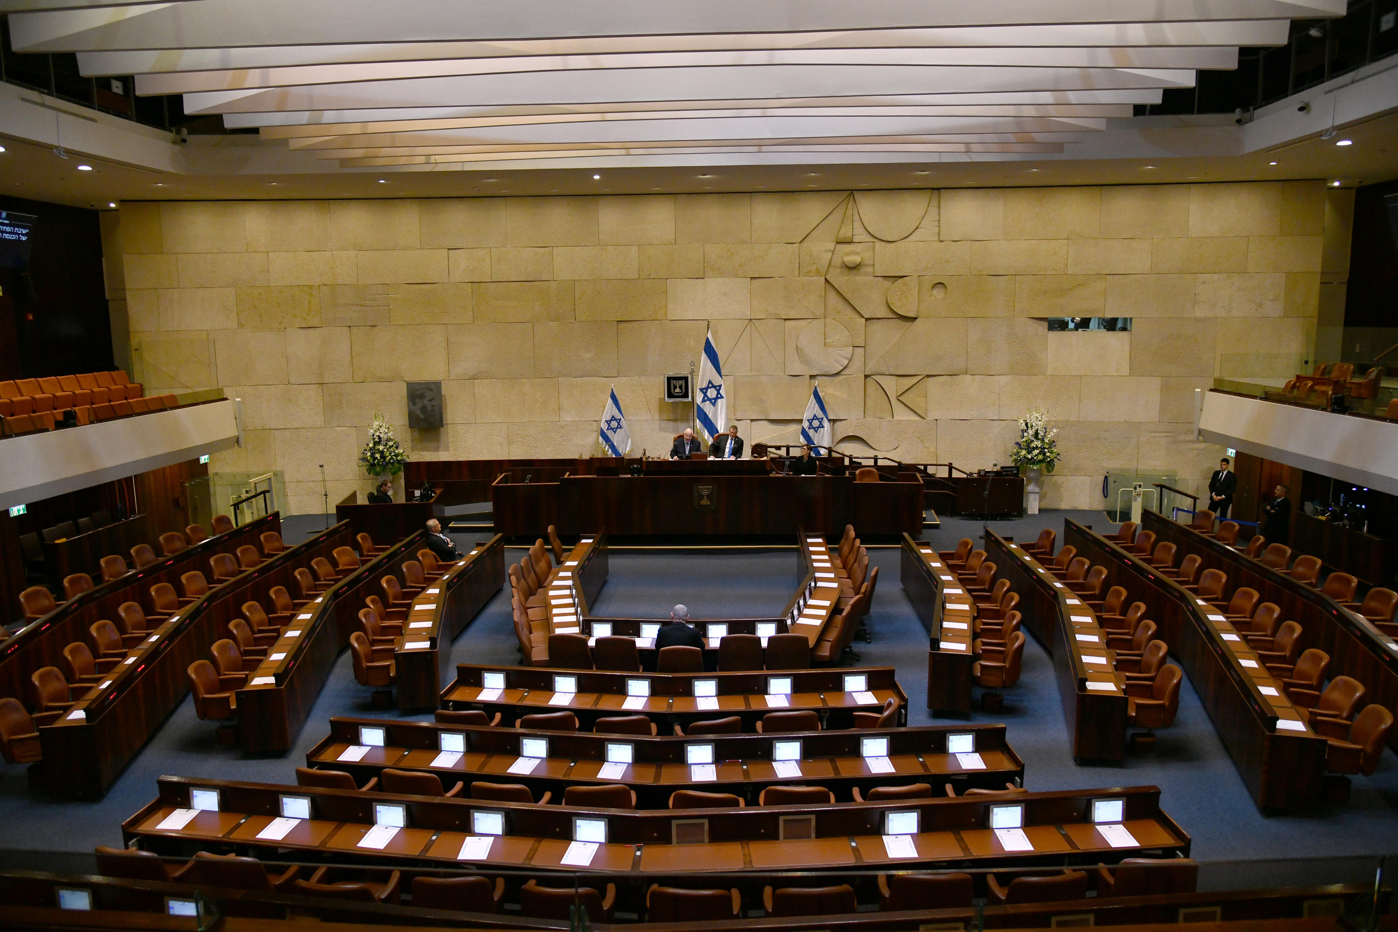
Why are there new elections, again?
Disagreement on the yearly budget
Fragile coalition
COVID and the influences
Netanyahu's trail

Slide 9
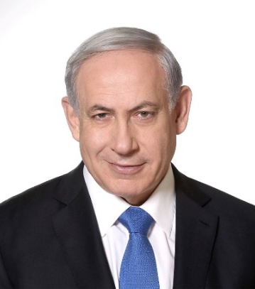
הליכוד HaLikud
The biggest party since 2009 and has been in power for 12 years
Benjamin Netanyahu is still in the process of trail about the corruption cases
Stands for a free market, Iranian threat, against unilateral withdrawal from the territories
Current seats - 36
Left
Right
Social democratic
Capitalist
Peace
Security
State
Religion

Slide 10
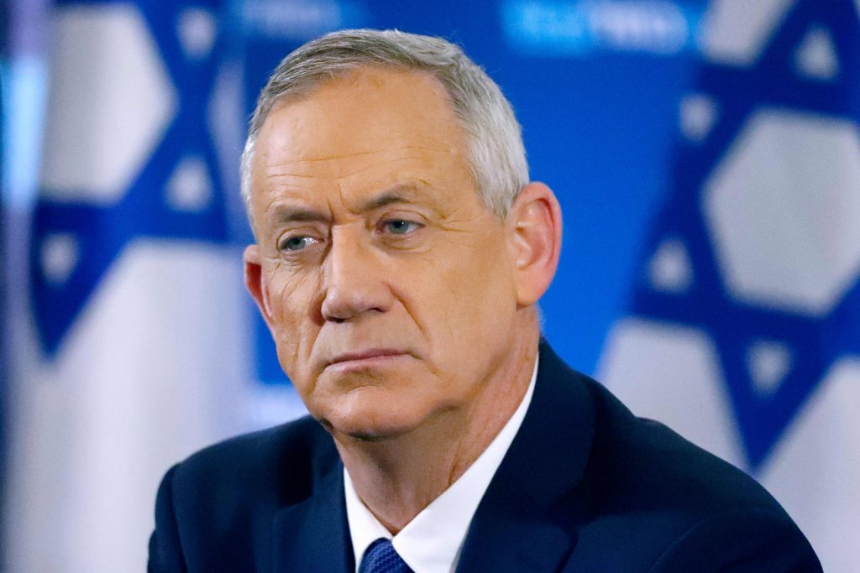
כחול לבן Blue & White
The party was established in 2019 and is a merge of “Chosen LeYisrael” and “Yesh Atid”
After the elections for the 23rd Knesset Gantz decided to join the coalition which caused “Yesh Atid” to leave the party
Led by Benny Gantz, an alternate Prime Minister of Israel
Stands for a political solution without withdrawing from the territories, public transportation on Shabbat, LGBTQ equal rights
Left
Right
Current seats - 13
Social
democratic
Capitalist
Peace
Security
State
Religion

Slide 11
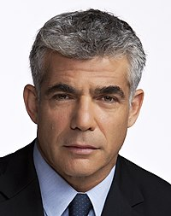
יש עתיד Yesh Atid
Left (along with Telem) Blue & White because they decided to join the government with Netanyahu
Wishes to replace Netanyahu
Stands for a political solution without withdrawing from the territories, public transportation on Shabbat, LGBTQ equal rights.
Left
Right
Current seats – 15
Social
democratic
Capitalist
Peace
Security
State
Religion

Slide 12
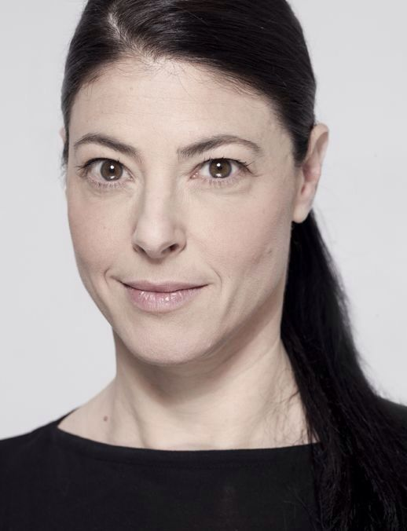
The Labor Party העבודה
Tradition party was established in 1968, now lead by Merav Michaeli.
For years the party was suffering from internal instability
Stands for a two-state solution, country without corruption, LGBTQ equal rights
Current seats – 3
Left
Right
Social democratic
Capitalist
Peace
Security
State
Religion

Slide 13
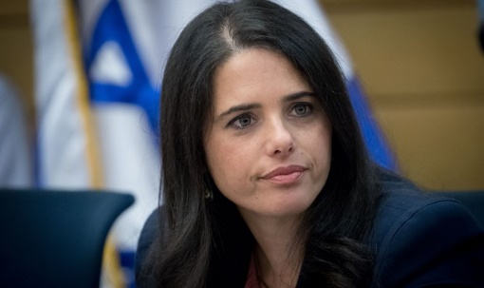
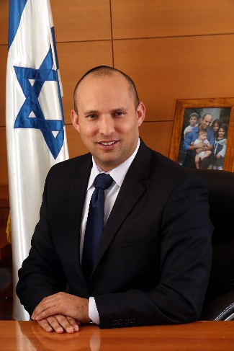
Yamina ימינה
Led by Nafatali Bennett and Ayalet Shaked, two former members of “Habait HaYehudi” party
Aims to be a bridge for religious and secular Israelis.
Stands strongly against two-state solution, Jerusalem united and Jewish
Left
Right
Current seats – 3
Social democratic
Capitalist
Peace
Security
State
Religion

Slide 14
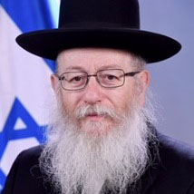
יהדות התורה המאוחדת United Torah Judaism
United Torah Judaism is a coalition of two Ultra-Orthodox parties
Ashkenazi – haredi party, only men
Will not take a role of a minister
Stands to promote the interests of the Haredi community, preserve the religious character of Israel
Current seats – 7
Left
Right
Social democratic
Capitalist
Peace
Security
State
Religion

Slide 15
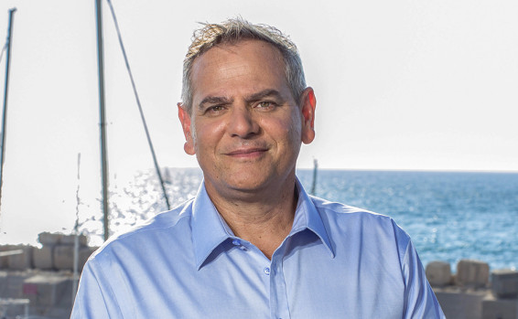
מרצ Meretz
Social democratic left-wing party
Considered today as an “extreme” left wing party
Stands for a two-state solution, Israel is the state of the Jewish people and a state of all its citizens, complete separation of religion and state
Current seats – 3
Left
Right
Social democratic
Capitalist
Peace
Security
State
Religion

Slide 16
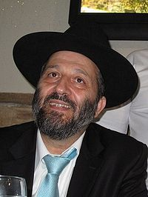
ש"ס Shas
Led by Aria Deri who was convicted of bribery, fraud, and breach of trust, and given a three-year jail sentence
At the end of 2012, ahead of the elections for the nineteenth Knesset, he returned to lead the “Shas” party
Sefardic – Zionist Haredi party, only men
Stands to promote the interests of the orthodox sefardic community, preserve the religious character of Israel
Current seats – 9
Left
Right
Social democratic
Capitalist
Peace
Security
State
Religion

Slide 17
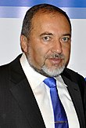
ישראל ביתנו Yisrael Beiteinu
Led by Avigdor Liberman, Russian-speaking Israelis, mostly secular
“Yes” to a Jewish state, “no” to a halakhic state
Announced that will not collaborate with Netanyahu anymore
Stands for mandatory recruitment for all, freedom from religion, two-state solution, death penalty for terrorists
Left
Right
Social democratic
Capitalist
Current seats – 7
Peace
Security
State
Religion

Slide 18
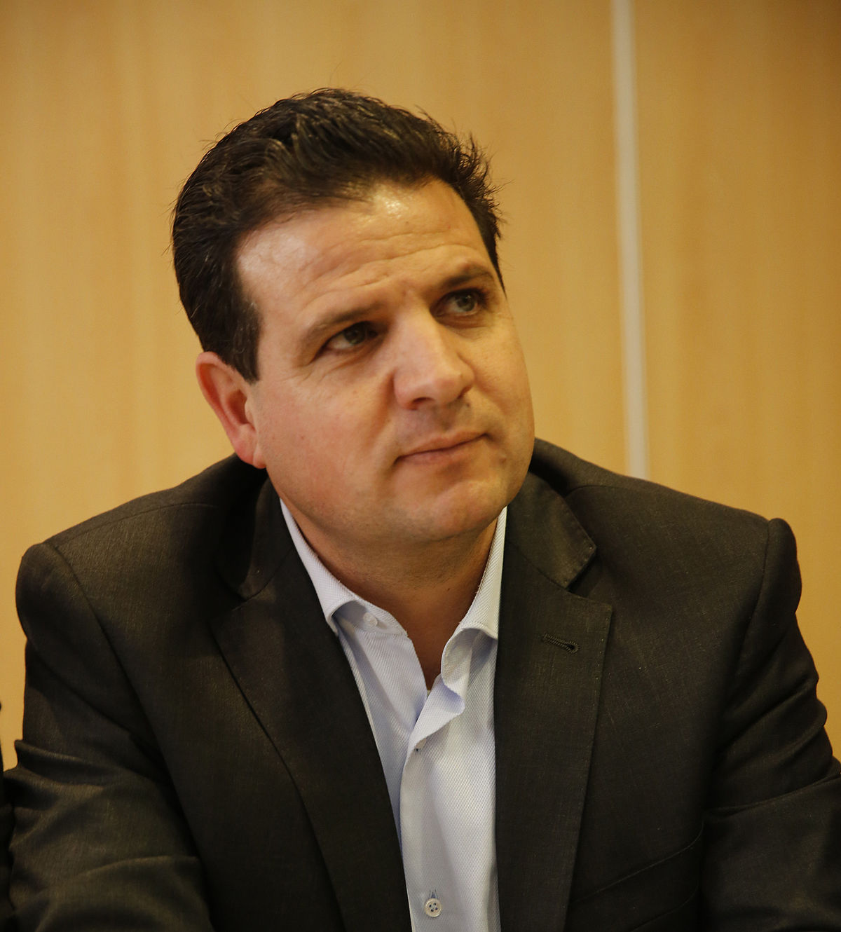
הרשימה המשותפת Join list
Two alliances of two Arab parties, each two parties, having only one Jewish member
Used to be united in “The Arab Parties Alliance” and disintegrated following internal disagreements
Criticized by both Arabs and Jews
Left
Right
Social democratic
Capitalist
Current seats – 15
Peace
Security
State
Religion

Slide 19
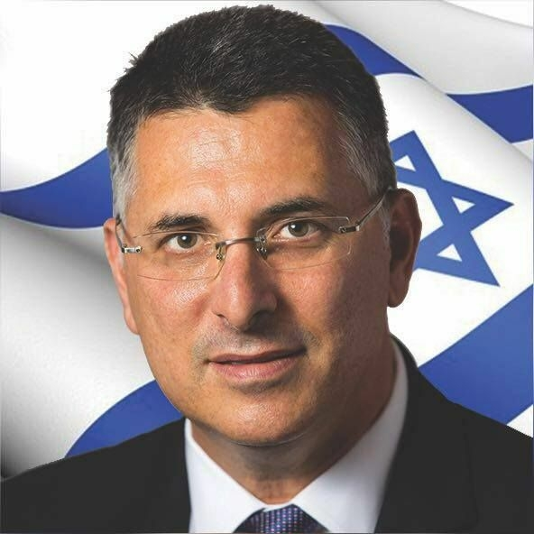
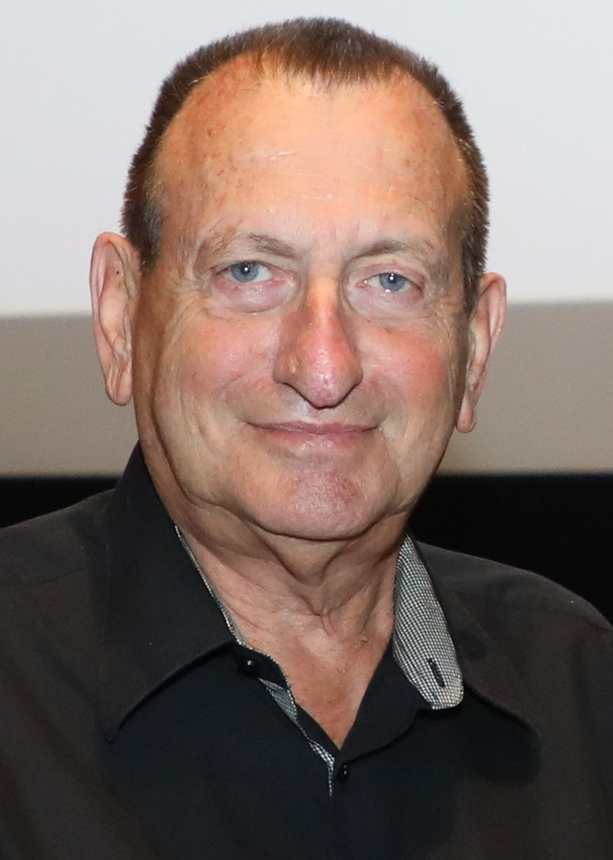
New players
New Hope
The Israelis
Gideon Saar was in the Likud for 11 years before taking a five-year break and returning in 2019 to try and take Netanyahu's seat. In 2021 he left the Likud to start New Hope.
Ron Huldai is the current mayor of Tel Aviv since 1998. He was asked to join politics many times, but only now agreed. His main goal is to replace Netanyahu.

Slide 20
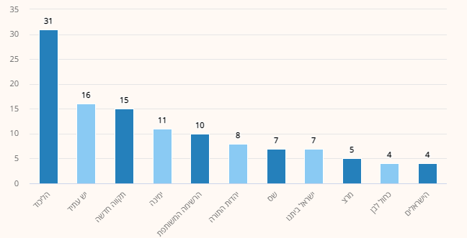
01/24/2020
Average of 5 different surveys
Likud
Yesh Atid
New Hope
Yamina
Joint list
United Torah Judaism
Shas
Israel Beitenu
Meretz
Blue and white
The Israelis

Slide 21
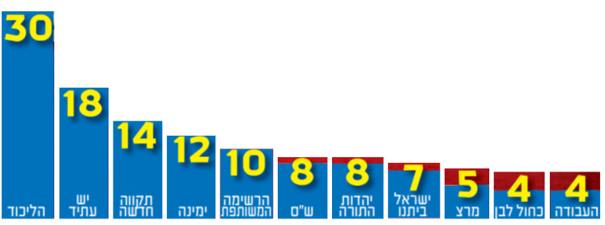
01/29/2020

Slide 22
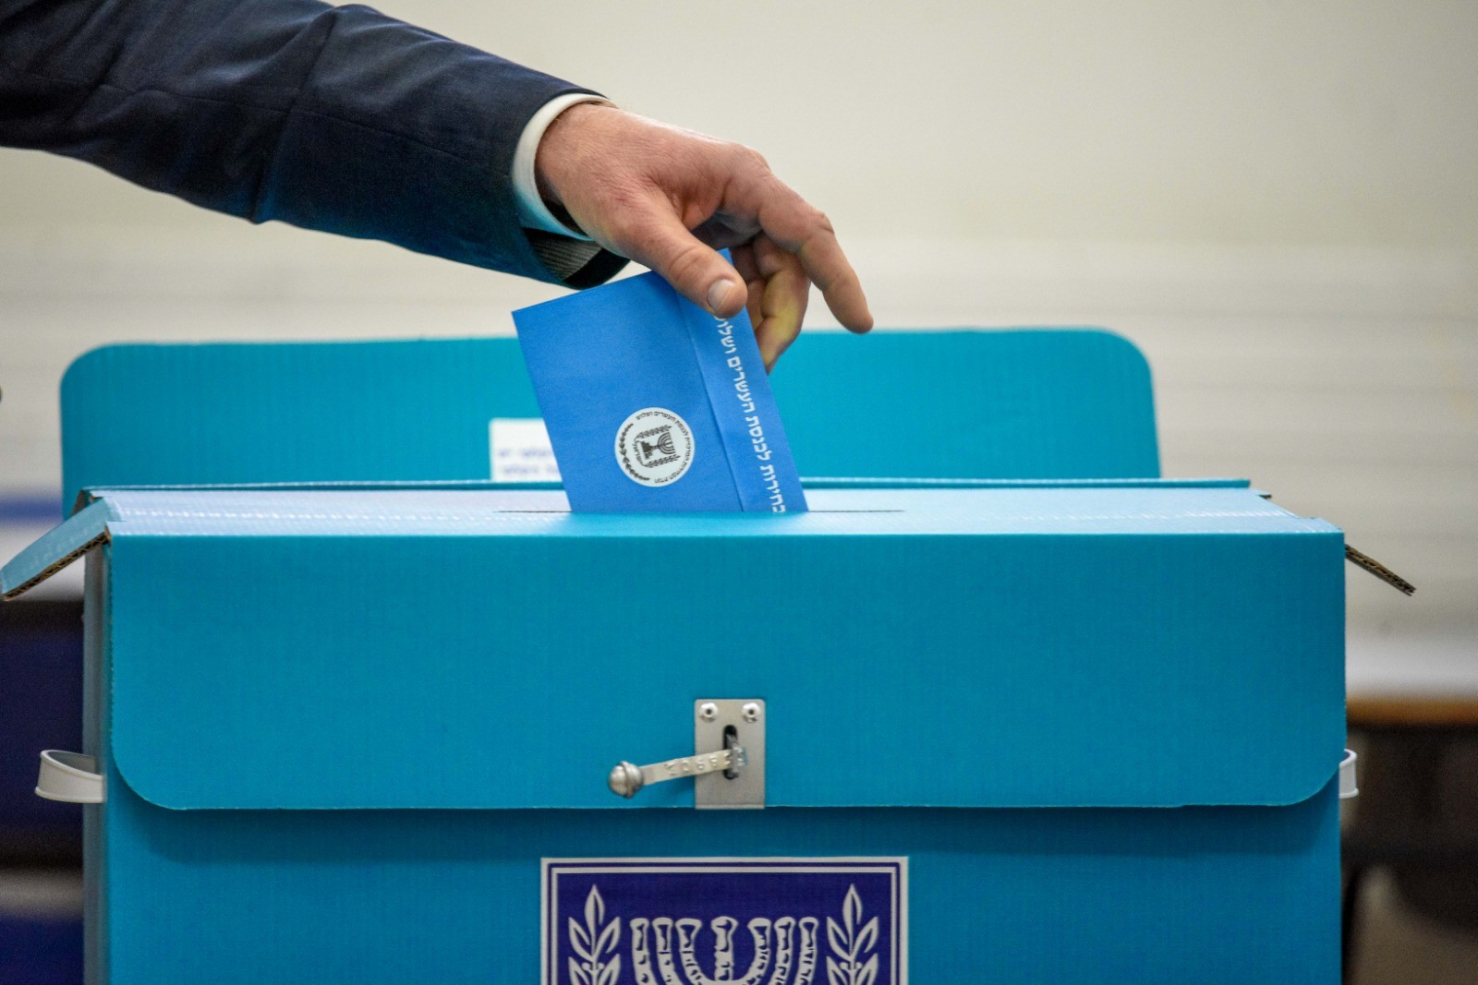
Our personal perspectives

Slide 23
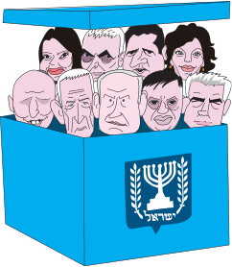
Questions?
Toda Raba!

