Slide 1

The history of alcohol And Zionism
by- Oded Gvaram

Slide 2
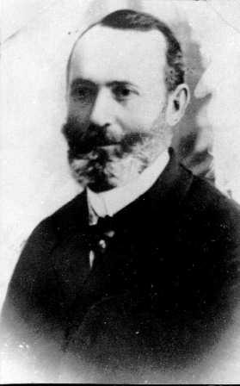
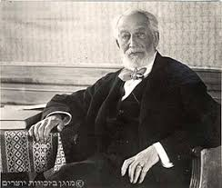

1882- The first steps-First Aliyah-First Winery
First Aliyah-1882- The Jewish settlers in Rishon Lezion encountered many economic problems due to lack of resources and water. Yosef Feinberg was chosen to find a solution to the problem by contributing to the Jewish community of Europe.
Yosef Feinberg met in France with Baron Rothschild and persuaded him to support the new settlements in Israel
Wineries are established in Rishon Letzion and Zichron Ya'akov, and the first harvest begins in 1889-1890

Slide 3


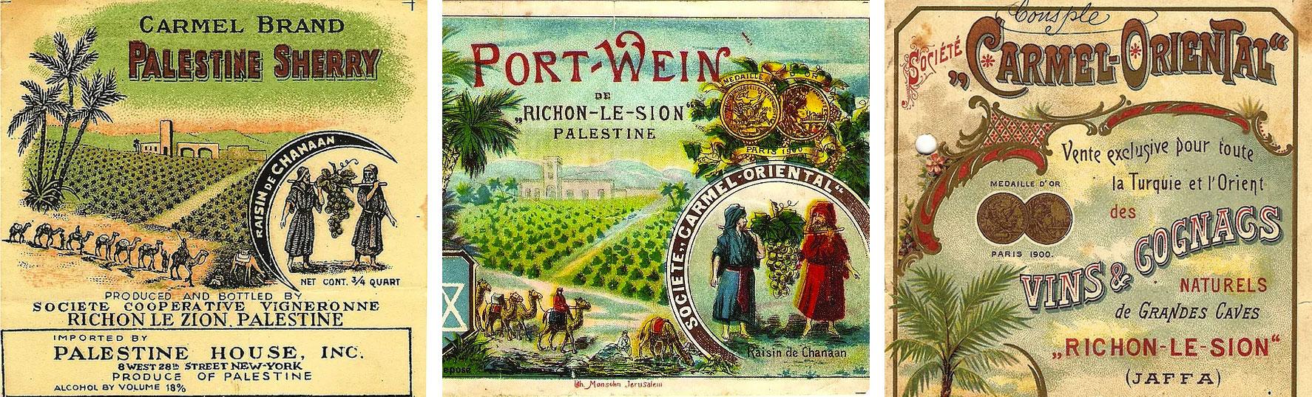
Carmel Winery nurtures some 3,500 acres of vineyards planted in the top growing regions in Israel. It also operates four wineries: the main historic winery in Zichron, being the oldest and largest commercial winery in Israel;
Carmel believes that wines should be of the highest quality no matter which market sector, tastes and styles are being catered to, from the most basic wines and up the scale to the higher priced prestigious wines

Slide 4


The song of Rishon Lezion Winery
When we 'will die, they will bury us in Rishon LeZion wineries.
There they have beautiful maidens Serve glasses full red, red wine.
When we 'will die, they will bury us in Rishon LeZion wineries.
There they have beautiful boys Serve glasses full red, red wine.
כְּשֶׁנָּמוּת יִקְבְּרוּ אוֹתָנוּ
בְּיִקְבֵי רִאשׁוֹן לְצִיּוֹן.
שָׁם יֶשְׁנָן עֲלָמוֹת
הַמַּגִּישׁוֹת כּוֹסוֹת
מְלֵאוֹת יַיִן אָדֹם אָדֹם.
כְּשֶׁנָּמוּת יִקְבְּרוּ אוֹתָנוּ
בְּיִקְבֵי רִאשׁוֹן לְצִיּוֹן.
שָׁם יֶשְׁנָם עֲלָמִים
הַמַּגִּישִׁים גְּבִיעִים
מְלֵאִים יַיִן אָדֹם אָדֹם.

Slide 5
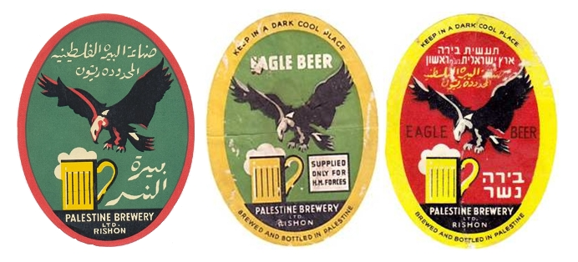
1936- Eagle(“Nesher”) Beer - First brewery
In 1934, Jacques Shapira began to set up a Nesher beer factory with the assistance of the Rothschild family.
The brewery was established in Rishon Letzion next to the beer marketing winery from the factory in January 1936
The main market of the brewery was soldiers in the British army in Palestine and the recipe for Nesher beer was prepared according to the taste of the soldiers
Today Nesher Beer is the largest malt beer in Israel

Slide 6
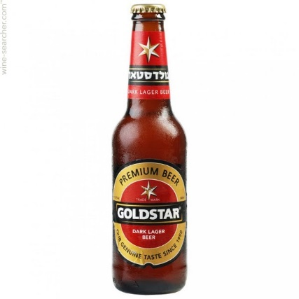
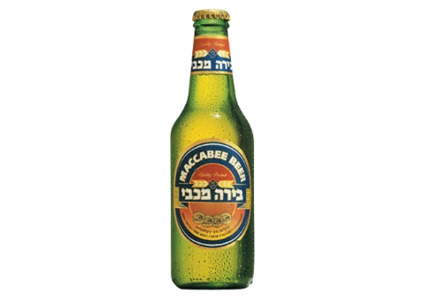
1948-1983- Depression in Israel
Following the establishment of the State of Israel, the Zionist ethos focused on the establishment and protection of the State. The economic situation made it impossible to create a developed culture of alcohol
in 1952 Tempo Company started to produce large quantities of beer
Goldstar is still the most popular beer in Israel (33% of the market)
In the 60s Tempo is introducing a new beer - Maccabi Beer

Slide 7
Reasons for the lack of development of alcohol culture in Israel
Economic crises at the beginning of the country
Alcohol is perceived as a luxury or as a dishonest thing to drink
Religious reasons - accustomed to drink cooked wine
These years were characterized by simple wine and beer and liqueurs

Slide 8
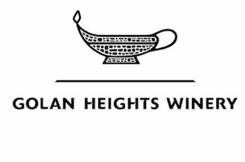


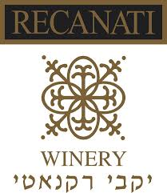
1980-2000 the Wine Renaissance
In 1983 -Golan Heights Winery is established
The winery focused on wine production for the global market,
As of the mid-1990s, boutique wineries began to appear in Israel
In order to compete with this trend Carmel Winery has its own unique wineries Kayoumi Winery and Alon Tavor Winery in the Galilee, and Yatir Winery in southern Israel’s Tel Arad.

Slide 9
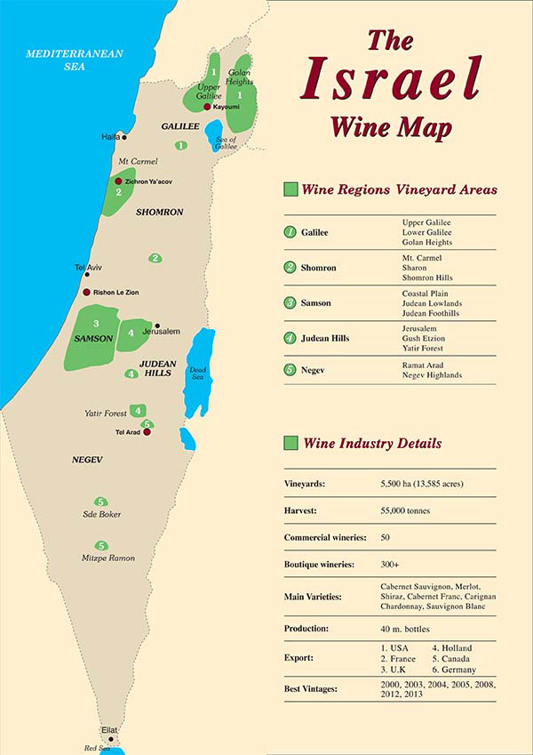

Slide 10
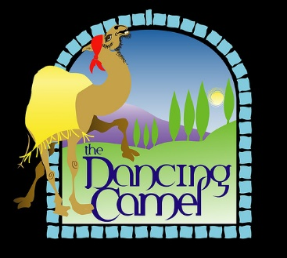
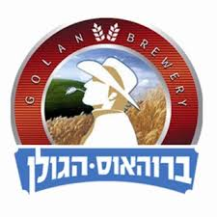
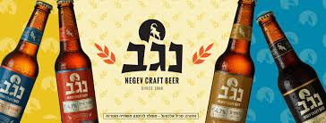

2000-Craft Beer Revolution
The Dancing Camel brewery, which opened in Tel Aviv in 2006, was the first craft
brewery to open in Israel and produces four types of beer
Today, about 1000 types of beers are produced in Israel throughout Israel
Tempo and Coca-Cola are the companies that control the Israeli beer market

Slide 11
2018-Alcohol culture in Israel today
We did not talk about Anise drinks in Israel (Arak / Ouzo)
Alcohol consumption in Israel has increased by 25% in the last two decades
Alcohol consumption is not associated with healthy alcohol culture.
Studies show that there is a dramatic increase in the consumption of alcohol among youth and increase in alcoholism in Israel.
Israel is still number 4 from end in OECD index for consumption of alcohol.

Slide 12
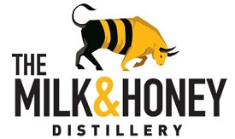
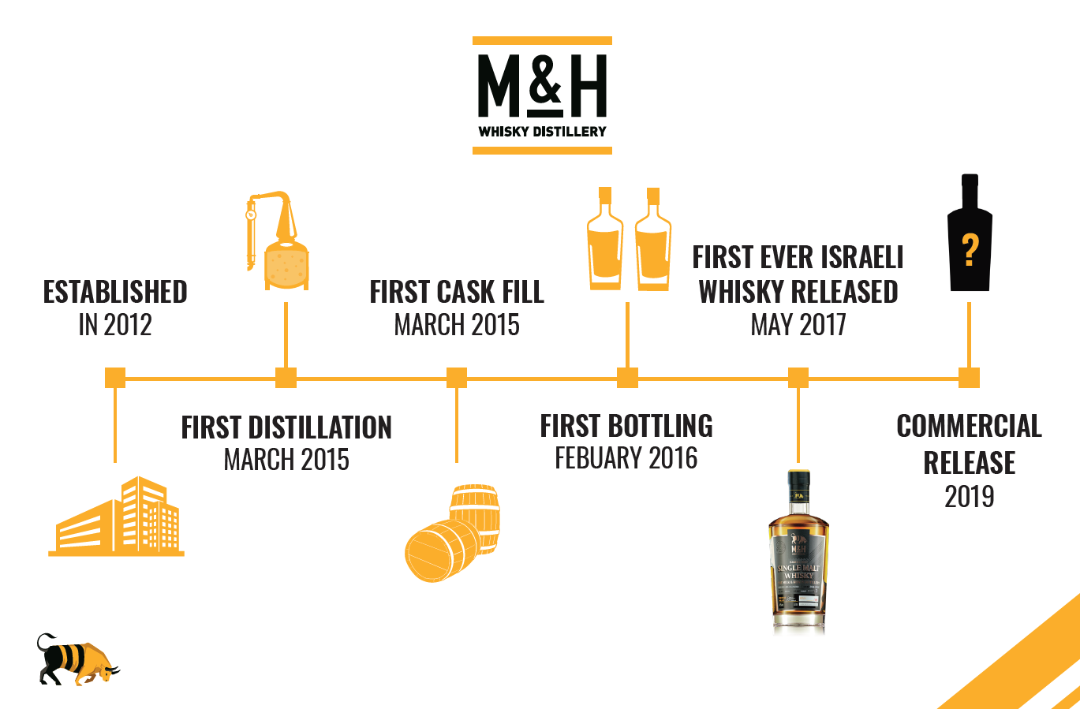

What Next- the Israel's first whiskey distillery
There are a small number of distilleries in Israel that distillery different liqueurs.
Today, Israel has three distillery that distillery’s whiskey, two in the Golan Heights The Pelter Refinery Golan Heights Distillery and one in Tel Aviv and the Milk&Honey distillery

Slide 13
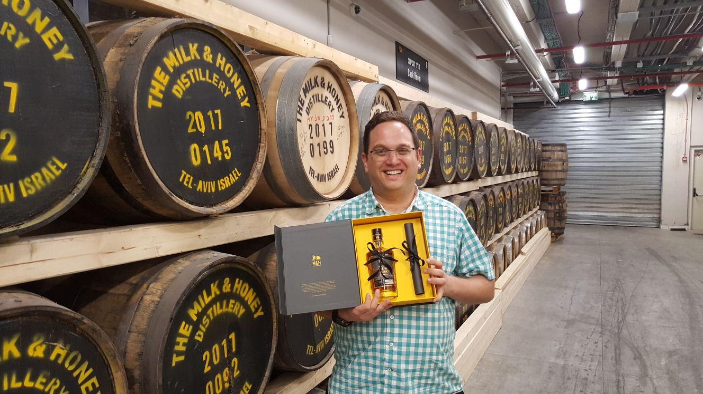
Let's taste it

